Slide 1
Econ 642: Week 10
Fiscal and Monetary Policies

Slide 2
Announcements
Discussion 10 is available
Problem Set 4 is available tomorrow and due on 2/11
It covers materials from week 9 and week 10
Exam is on 2/14 and covers Week 7 through Week 11
Note that a lot of material we cover comes from our first half of the class

Slide 3
Overview
Most governments and central banks follow some version of the New Keynesian when setting fiscal or monetary policies
Fiscal Policy
Monetary Policy
Expectations and natural rates
Types of monetary regimes
Liquidity Traps

Slide 4
Aggregate Demand
Implicit in our discussion from Week 9, IS-LM, aggregate demand is derived from our points
At different points where the IS and LM equations intersect gets us points along the AD curve
Holding all exogenous factors constant, we can derive the AD curve as the LM curve shifts along the IS curve
Aggregate Demand is a function of prices and output
Prices and output are inversely related with AD
The Phillips Curve we focused on how prices and output interacted from producers and formed a positive relationship

Slide 5
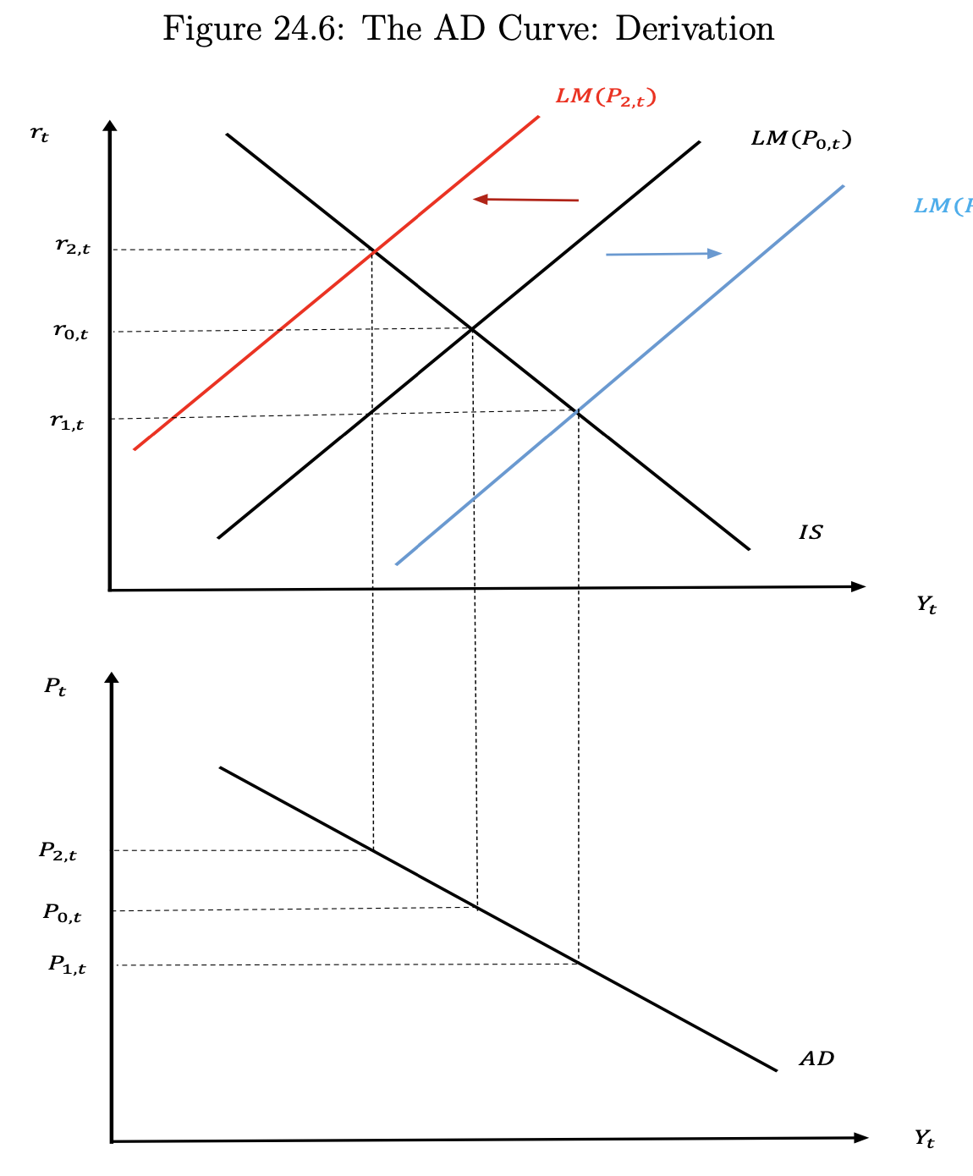
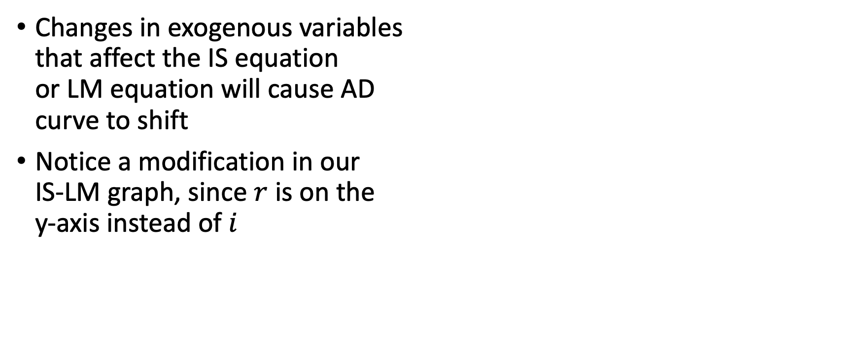
Aggregate Demand
Changes in exogenous variables that affect the IS equation or LM equation will cause AD curve to shift
Notice a modification in our IS-LM graph, since $r$ is on the y-axis instead of $i$

Slide 6
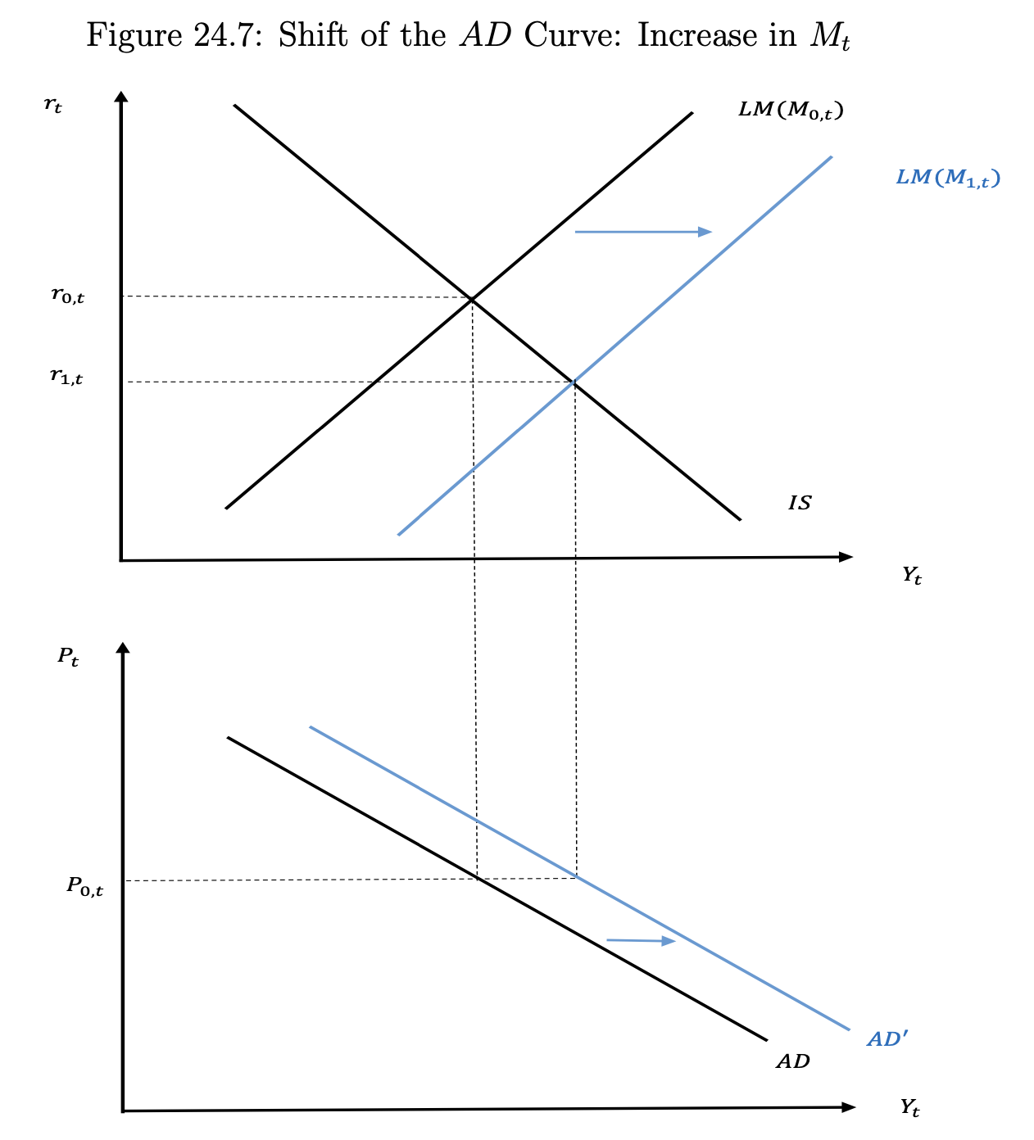
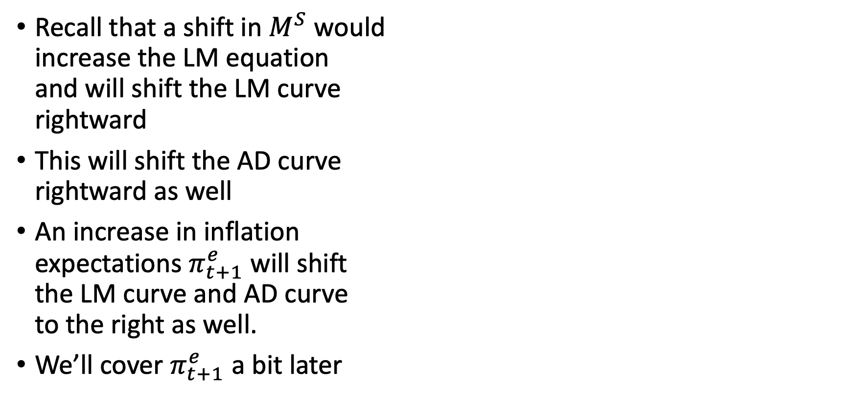
Aggregate Demand
Recall that a shift in $M^{S}$ would increase the LM equation and will shift the LM curve rightward
This will shift the AD curve rightward as well
An increase in inflation expectations $π_{t+1}^{e}$ will shift the LM curve and AD curve to the right as well.
We’ll cover $π_{t+1}^{e}$ a bit later

Slide 7
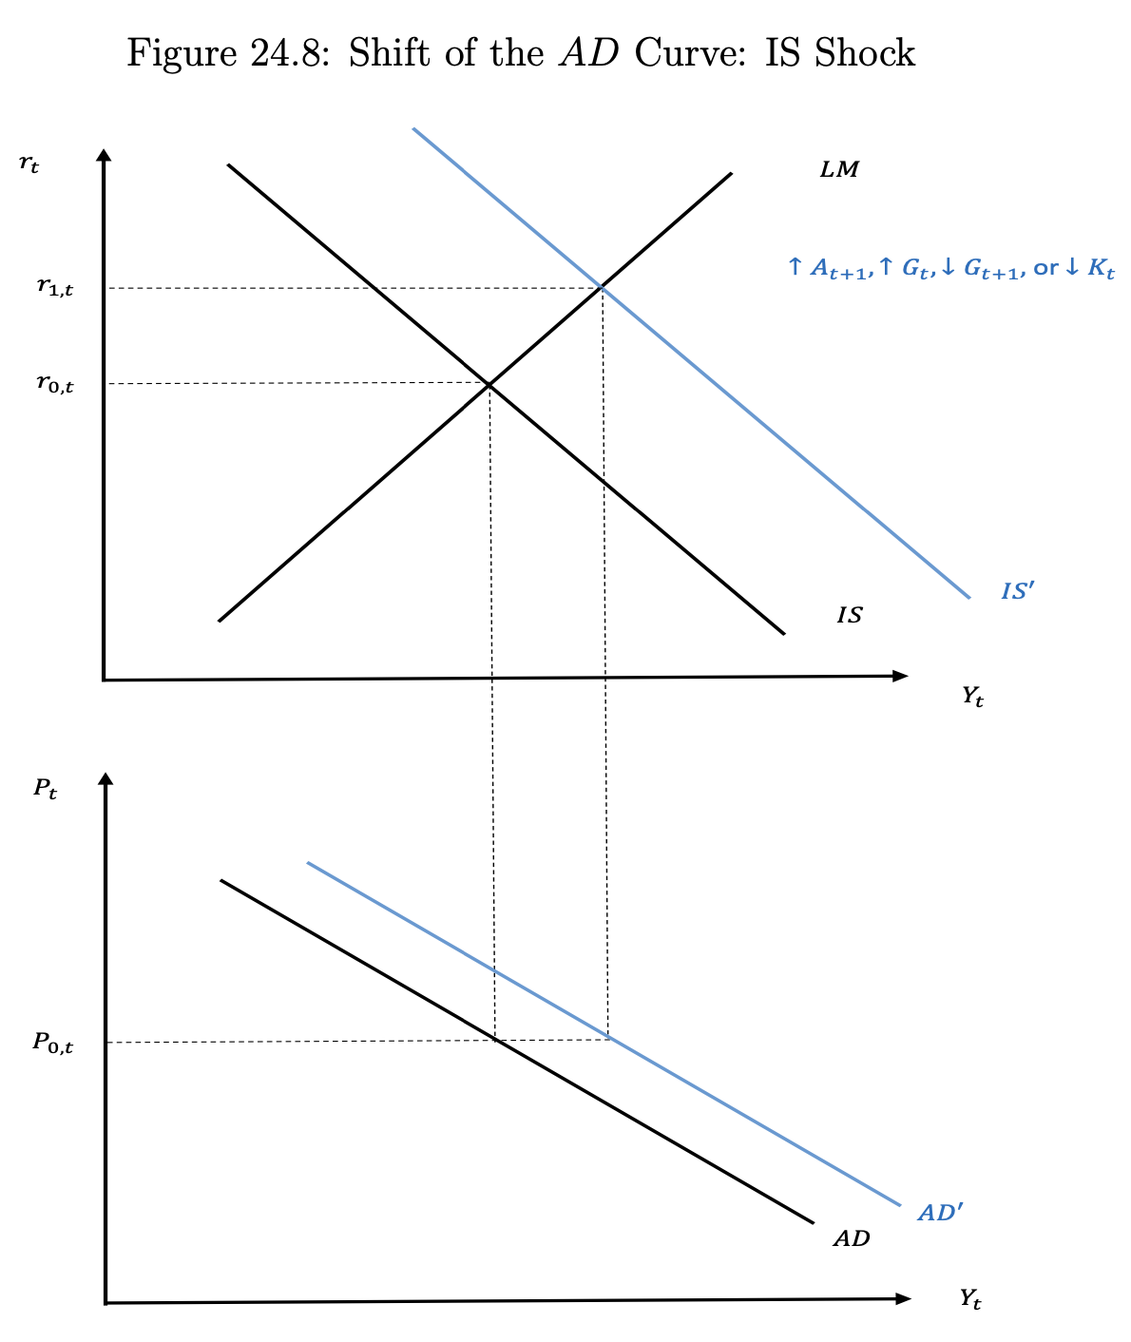
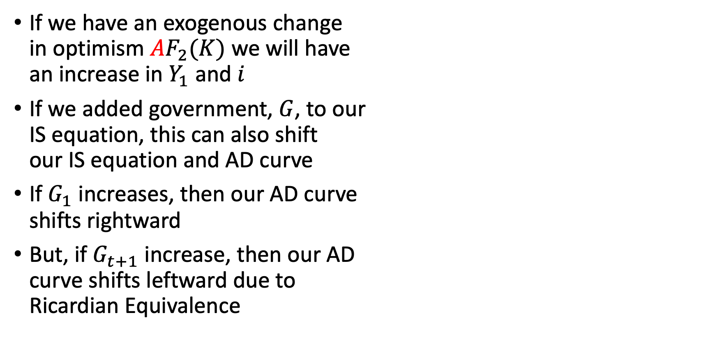
Aggregate Demand
If we have an exogenous change in optimism $AF_{2}(K)$ we will have an increase in $Y_{1}$ and $i$
If we added government, $G$, to our IS equation, this can also shift our IS equation and AD curve
If $G_{1}$ increases, then our AD curve shifts rightward
But, if $G_{t+1}$ increase, then our AD curve shifts leftward due to Ricardian Equivalence

Slide 8
Fiscal Policy
Kurlat Chapter 15

Slide 9
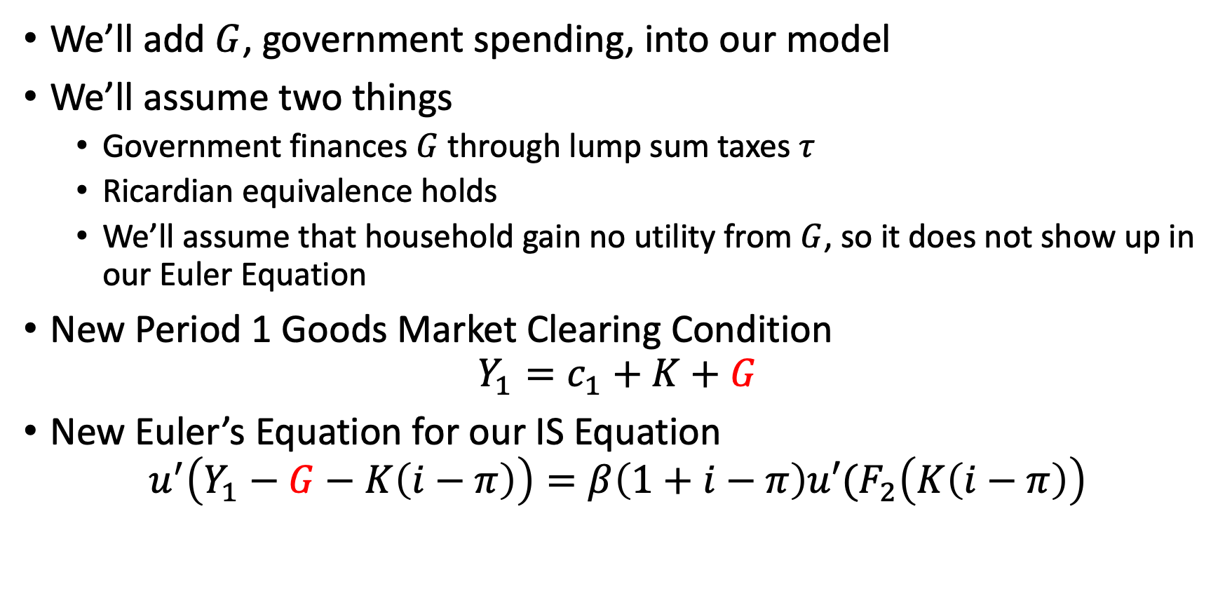
Fiscal Policy
We’ll add $G$, government spending, into our model
We’ll assume two things
Government finances $G$ through lump sum taxes $τ$
Ricardian equivalence holds
We’ll assume that household gain no utility from $G$, so it does not show up in our Euler Equation
New Period 1 Goods Market Clearing Condition
$$Y_{1}=c_{1}+K+G$$
New Euler’s Equation for our IS Equation
$$u^{′}\left(Y_{1}−G−K\left(i−π\right)\right)=β\left(1+i−π\right)u′(F_{2}\left(K\left(i−π\right)\right)$$

Slide 10
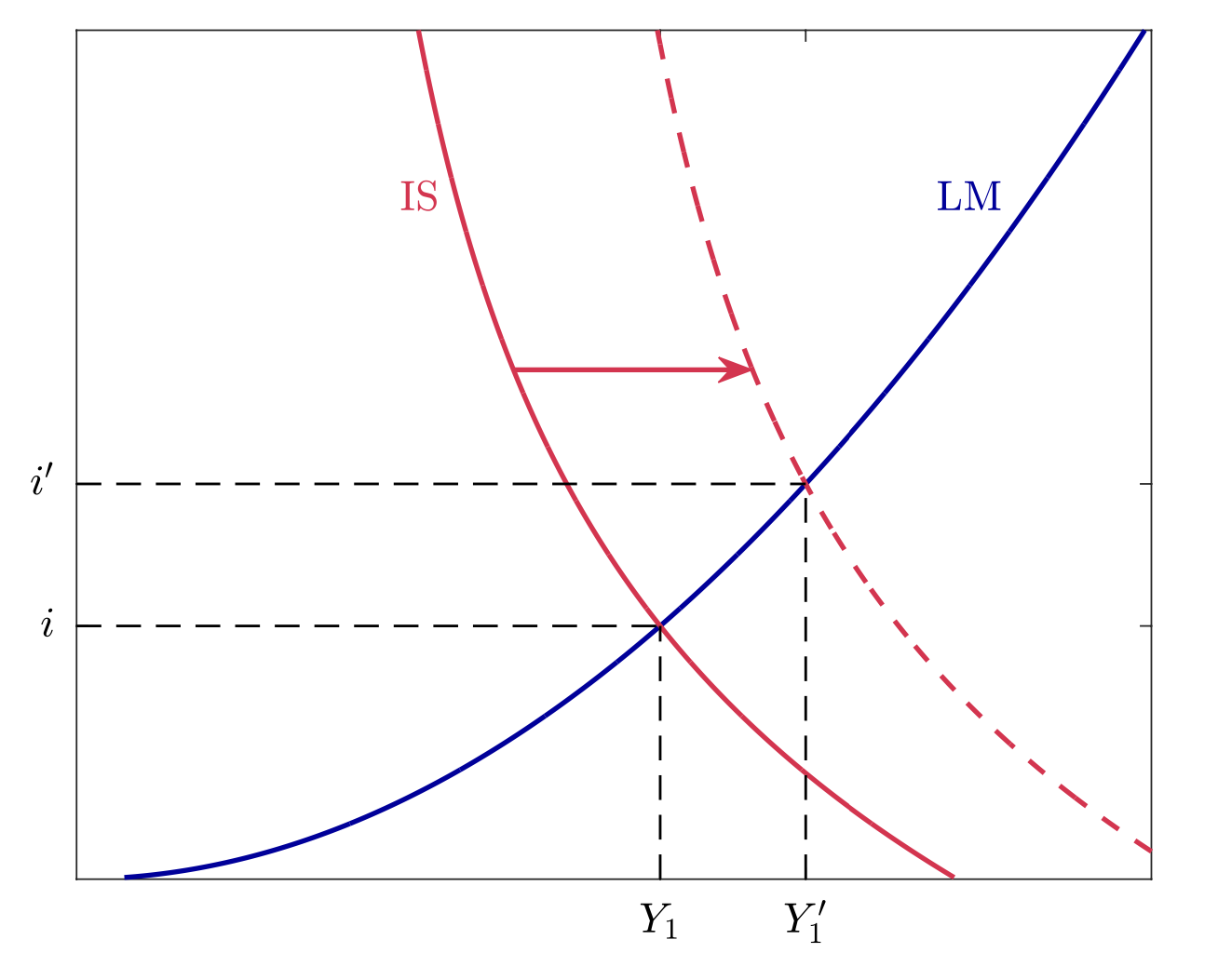
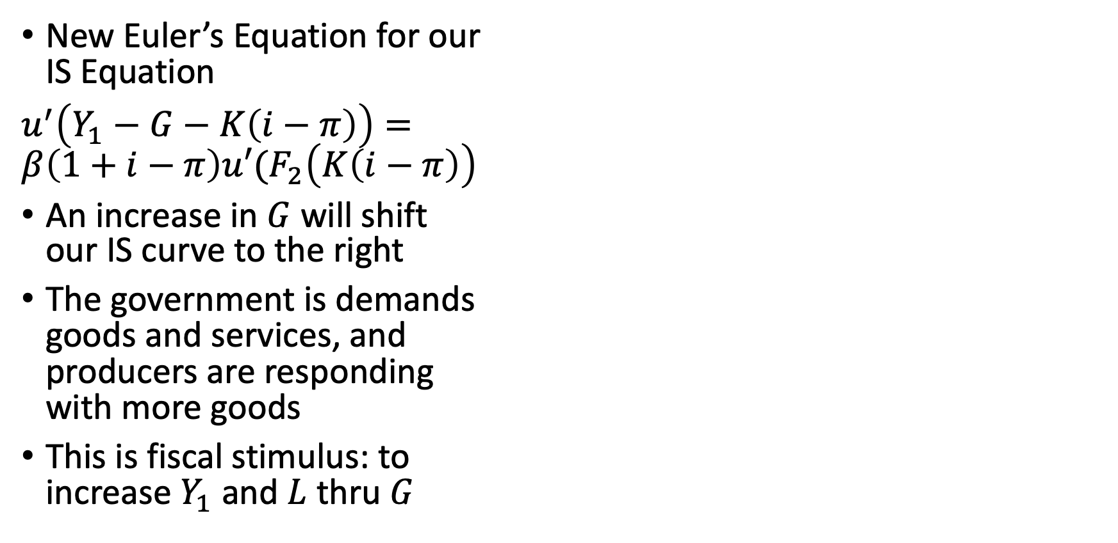
Fiscal Policy
New Euler’s Equation for our IS Equation
$u^{′}\left(Y_{1}−G−K\left(i−π\right)\right)=$ $β\left(1+i−π\right)u′(F_{2}\left(K\left(i−π\right)\right)$
An increase in $G$ will shift our IS curve to the right
The government is demands goods and services, and producers are responding with more goods
This is fiscal stimulus: to increase $Y_{1}$ and $L$ thru $G$

Slide 11
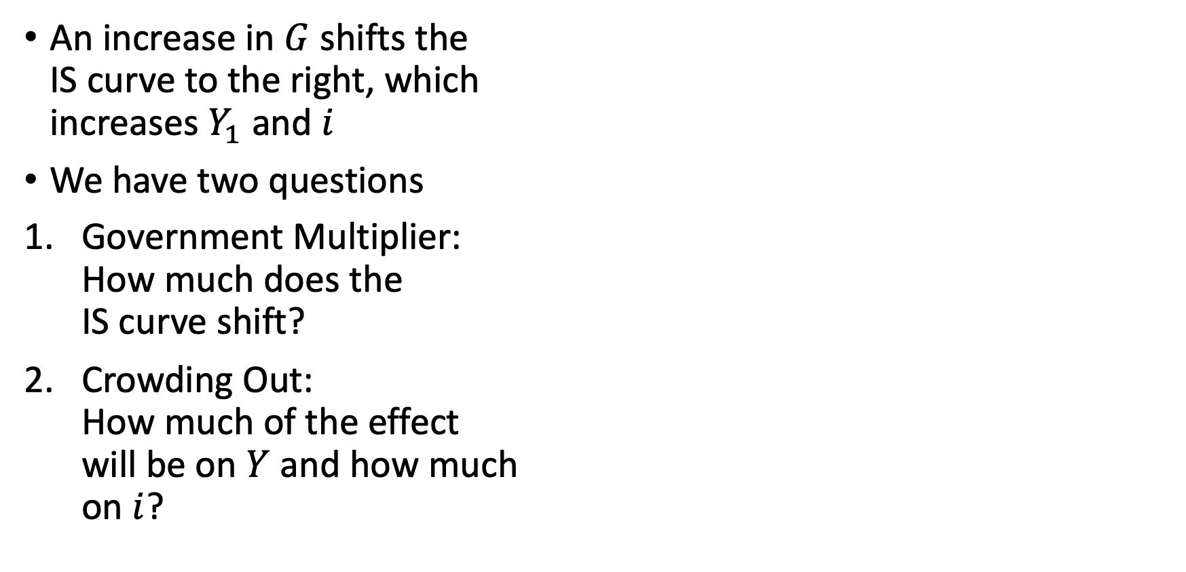
Fiscal Policy
An increase in $G$ shifts the IS curve to the right, which increases $Y_{1}$ and $i$
We have two questions
Government Multiplier: How much does the IS curve shift?
Crowding Out: How much of the effect will be on $Y$ and how much on $i$?

Slide 12
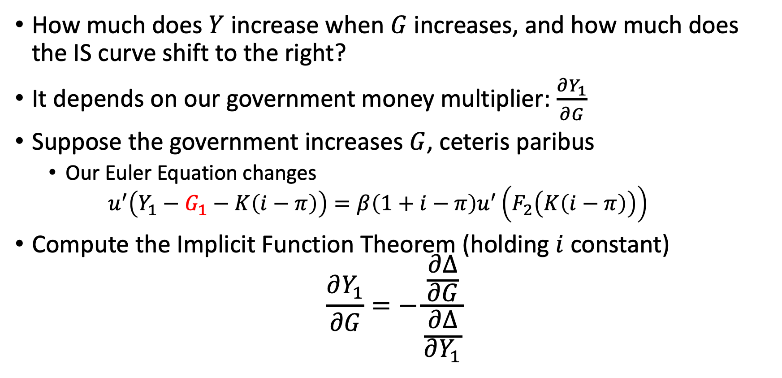
The Government Money Multiplier
How much does $Y$ increase when $G$ increases, and how much does the IS curve shift to the right?
It depends on our government money multiplier: $\frac{∂Y_{1}}{∂G}$
Suppose the government increases $G$, ceteris paribus
Our Euler Equation changes
$$u^{′}\left(Y_{1}−G_{1}−K\left(i−π\right)\right)=β\left(1+i−π\right)u^{′}\left(F_{2}\left(K\left(i−π\right)\right)\right)$$
Compute the Implicit Function Theorem (holding $i$ constant)
$$\frac{∂Y_{1}}{∂G}=−\frac{\frac{∂Δ}{∂G}}{\frac{∂Δ}{∂Y_{1}}}$$

Slide 13
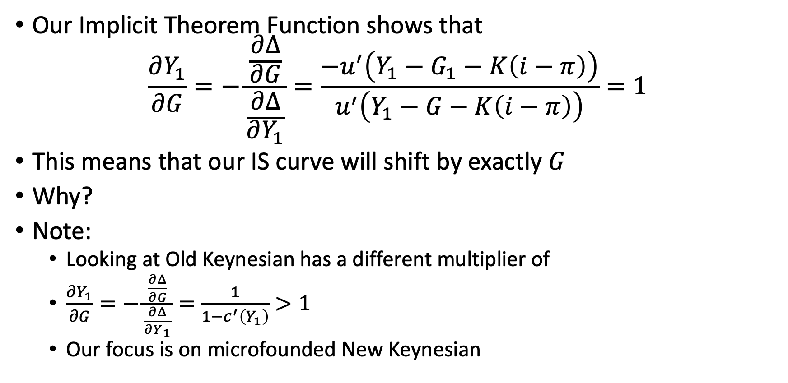
The Government Money Multiplier
Our Implicit Theorem Function shows that
$$\frac{∂Y_{1}}{∂G}=−\frac{\frac{∂Δ}{∂G}}{\frac{∂Δ}{∂Y_{1}}}=\frac{−u^{′}\left(Y_{1}−G_{1}−K\left(i−π\right)\right)}{u^{′}\left(Y_{1}−G−K\left(i−π\right)\right)}=1$$
This means that our IS curve will shift by exactly $G$
Why?
Note:
Looking at Old Keynesian has a different multiplier of
$\frac{∂Y_{1}}{∂G}=−\frac{\frac{∂Δ}{∂G}}{\frac{∂Δ}{∂Y_{1}}}=\frac{1}{1−c^{′}\left(Y_{1}\right)}>1$
Our focus is on microfounded New Keynesian

Slide 14
The Government Money Multiplier
There is a direct effect when the government spends on public goods
Producers increase output and earn additional income from selling goods to the government
We do not to be specific when the government collects the taxes
Producers are rational and understand that the government will have to increase taxes to pay for the spending either now or in the future
Present value of after-tax income has not changed, so consumption does not change, so the IS curve shifts to the right

Slide 15
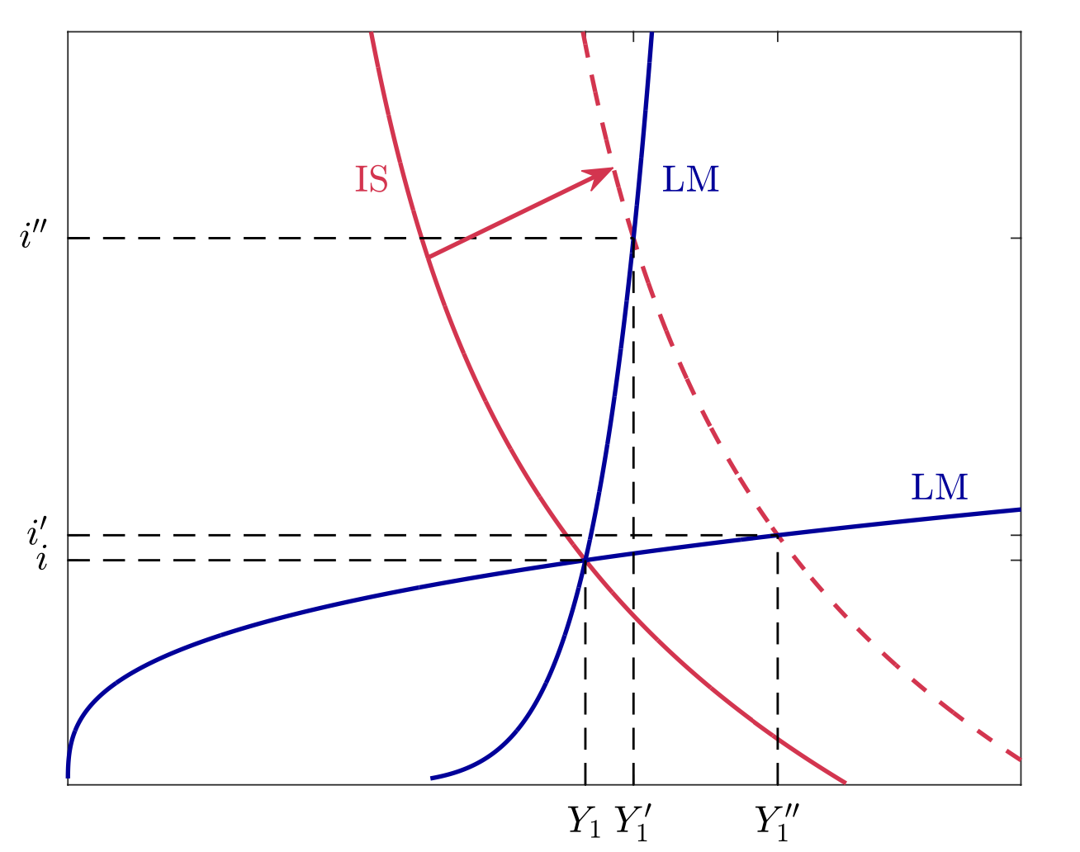
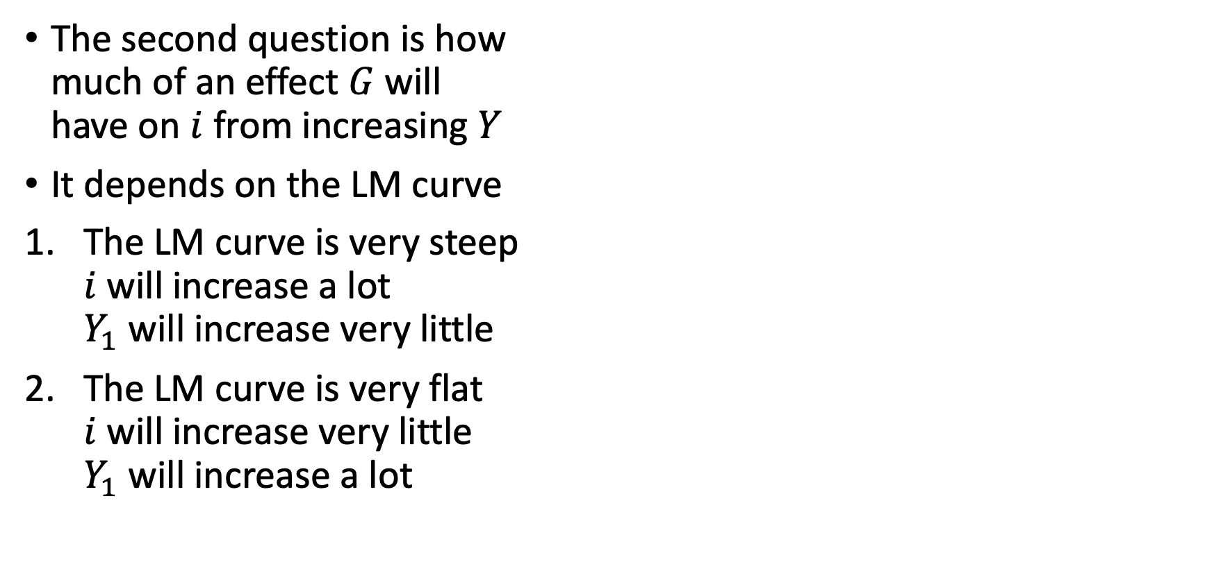
Crowding out
The second question is how much of an effect $G$ will have on $i$ from increasing $Y$
It depends on the LM curve
The LM curve is very steep $i$ will increase a lot $Y_{1}$ will increase very little
The LM curve is very flat $i$ will increase very little $Y_{1}$ will increase a lot

Slide 16
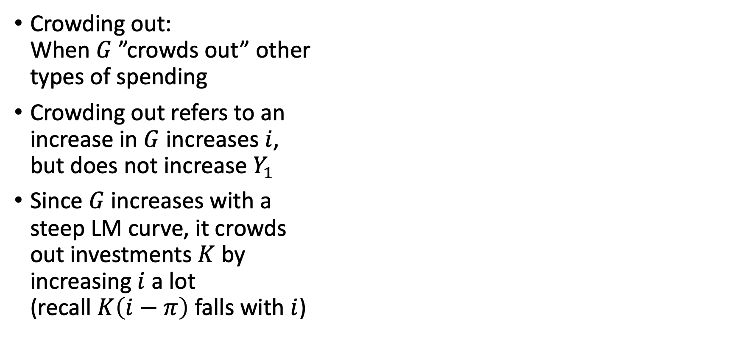
Crowding out
Crowding out: When $G$ ”crowds out” other types of spending
Crowding out refers to an increase in $G$ increases $i$, but does not increase $Y_{1}$
Since $G$ increases with a steep LM curve, it crowds out investments $K$ by increasing $i$ a lot (recall $K\left(i−π\right)$ falls with $i$)

Slide 17
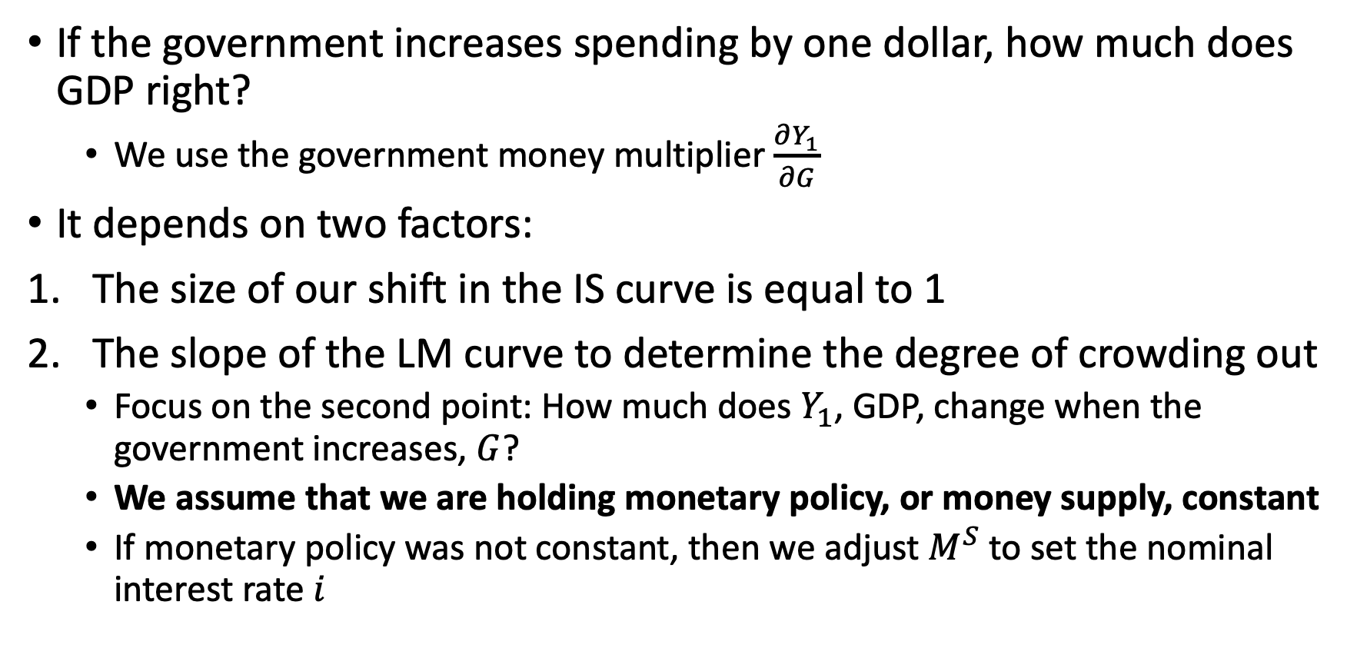
Fiscal Policy
If the government increases spending by one dollar, how much does GDP right?
We use the government money multiplier $\frac{∂Y_{1}}{∂G}$
It depends on two factors:
The size of our shift in the IS curve is equal to 1
The slope of the LM curve to determine the degree of crowding out
Focus on the second point: How much does $Y_{1}$, GDP, change when the government increases, $G$?
We assume that we are holding monetary policy, or money supply, constant
If monetary policy was not constant, then we adjust $M^{S}$ to set the nominal interest rate $i$

Slide 18
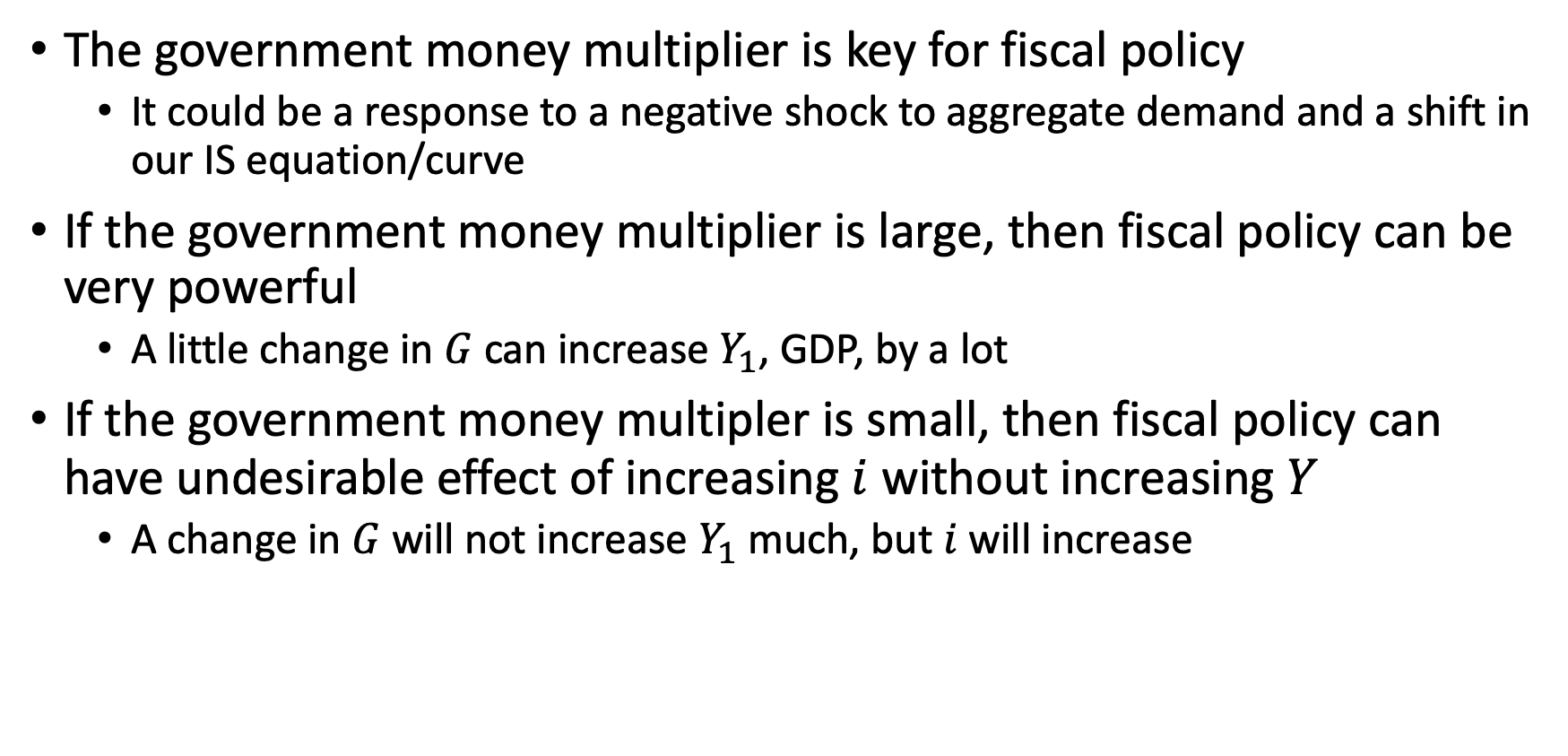
Fiscal Policy
The government money multiplier is key for fiscal policy
It could be a response to a negative shock to aggregate demand and a shift in our IS equation/curve
If the government money multiplier is large, then fiscal policy can be very powerful
A little change in $G$ can increase $Y_{1}$, GDP, by a lot
If the government money multipler is small, then fiscal policy can have undesirable effect of increasing $i$ without increasing $Y$
A change in $G$ will not increase $Y_{1}$ much, but $i$ will increase

Slide 19
Monetary Policy
Kurlat Chapter 15

Slide 20
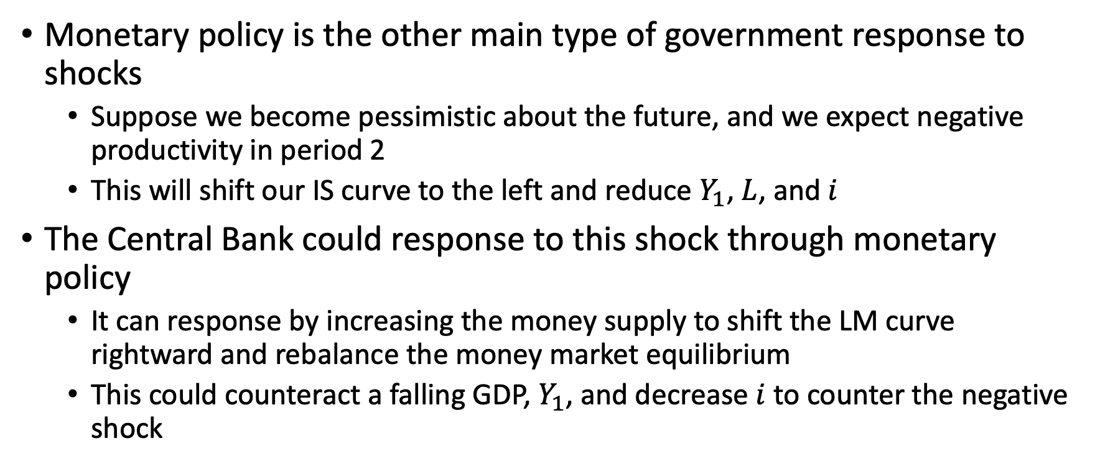
Monetary Policy
Monetary policy is the other main type of government response to shocks
Suppose we become pessimistic about the future, and we expect negative productivity in period 2
This will shift our IS curve to the left and reduce $Y_{1}$, $L$, and $i$
The Central Bank could response to this shock through monetary policy
It can response by increasing the money supply to shift the LM curve rightward and rebalance the money market equilibrium
This could counteract a falling GDP, $Y_{1}$, and decrease $i$ to counter the negative shock

Slide 21
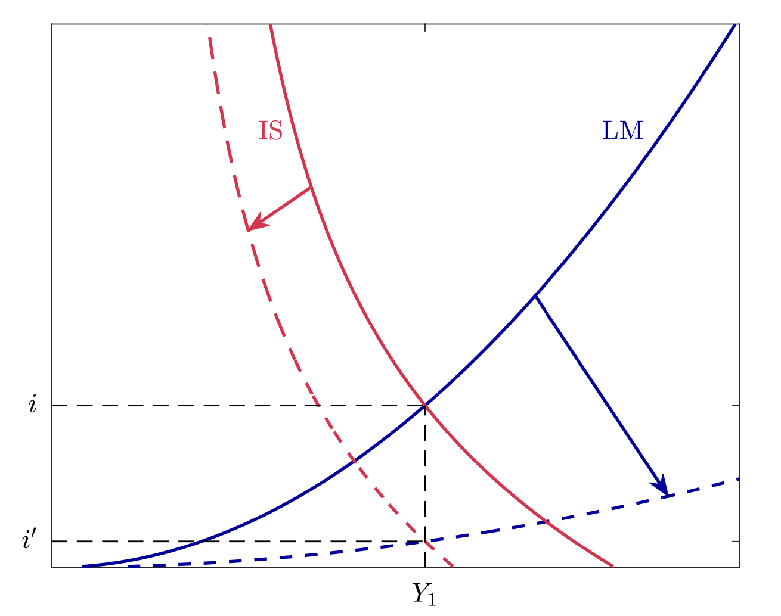
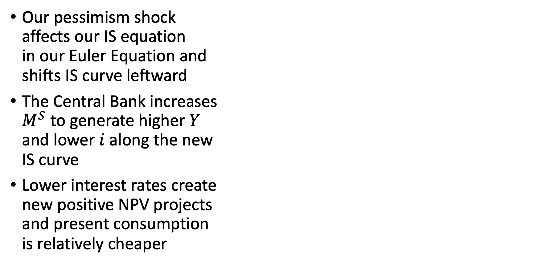
Monetary Policy
Our pessimism shock affects our IS equation in our Euler Equation and shifts IS curve leftward
The Central Bank increases $M^{S}$ to generate higher $Y$ and lower $i$ along the new IS curve
Lower interest rates create new positive NPV projects and present consumption is relatively cheaper

Slide 22
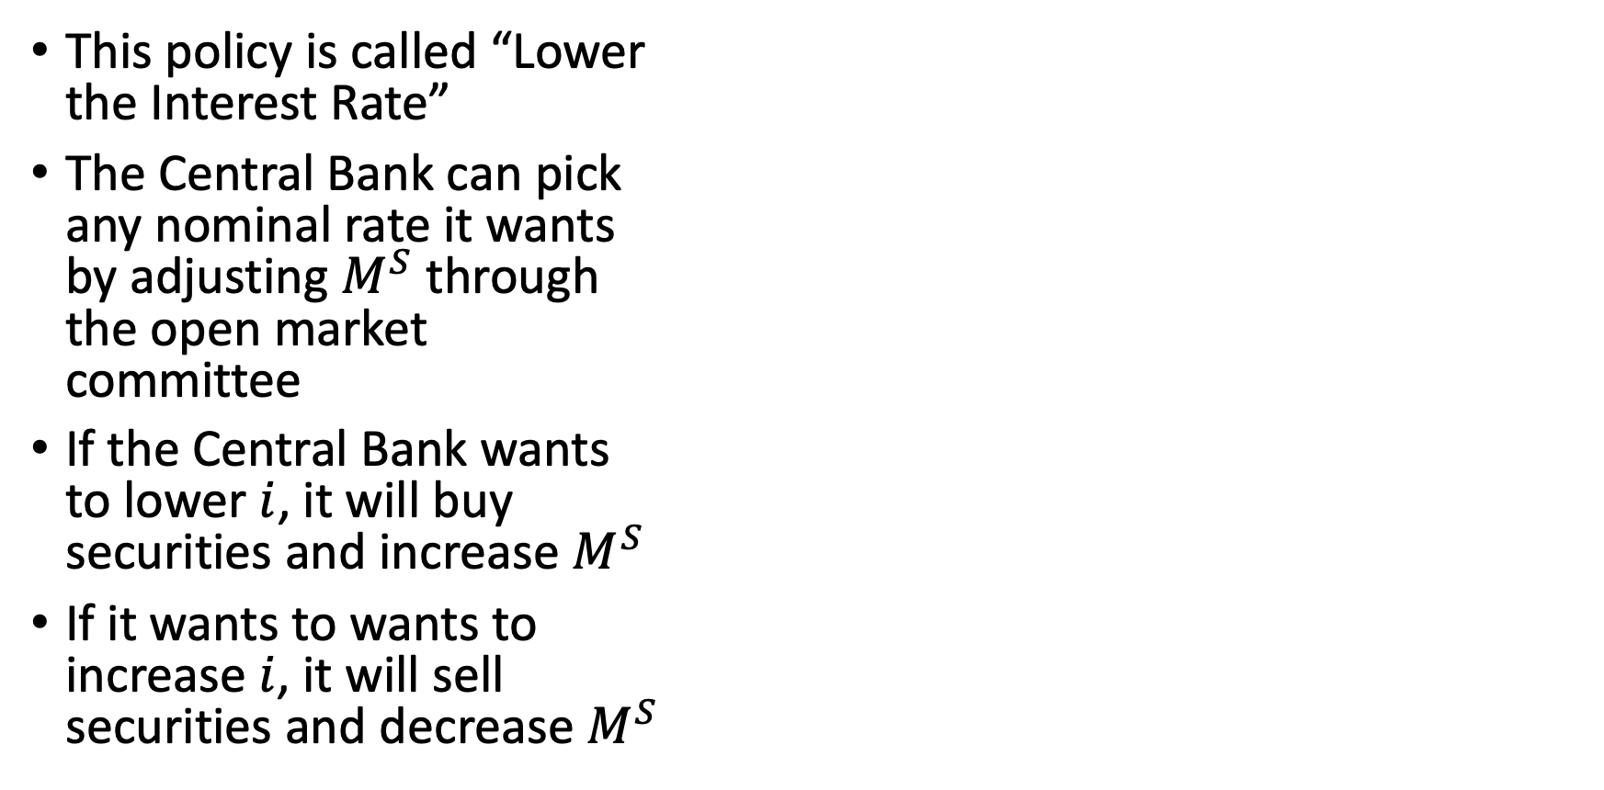
Monetary Policy
This policy is called “Lower the Interest Rate”
The Central Bank can pick any nominal rate it wants by adjusting $M^{S}$ through the open market committee
If the Central Bank wants to lower $i$, it will buy securities and increase $M^{S}$
If it wants to wants to increase $i$, it will sell securities and decrease $M^{S}$

Slide 23
Monetary Policy
“Lowering the Interest Rate” is one of the policy responses the Central Bank as to offset a negative shock
One of the challenges is knowing what kind of shock has occurred
Note: the policy may not be to stabilize GDP, but prices
The Central Bank may have a policy to get the economy to behave as if prices were not sticky

Slide 24
Expectations and Augmented Phillips Curve

Slide 25
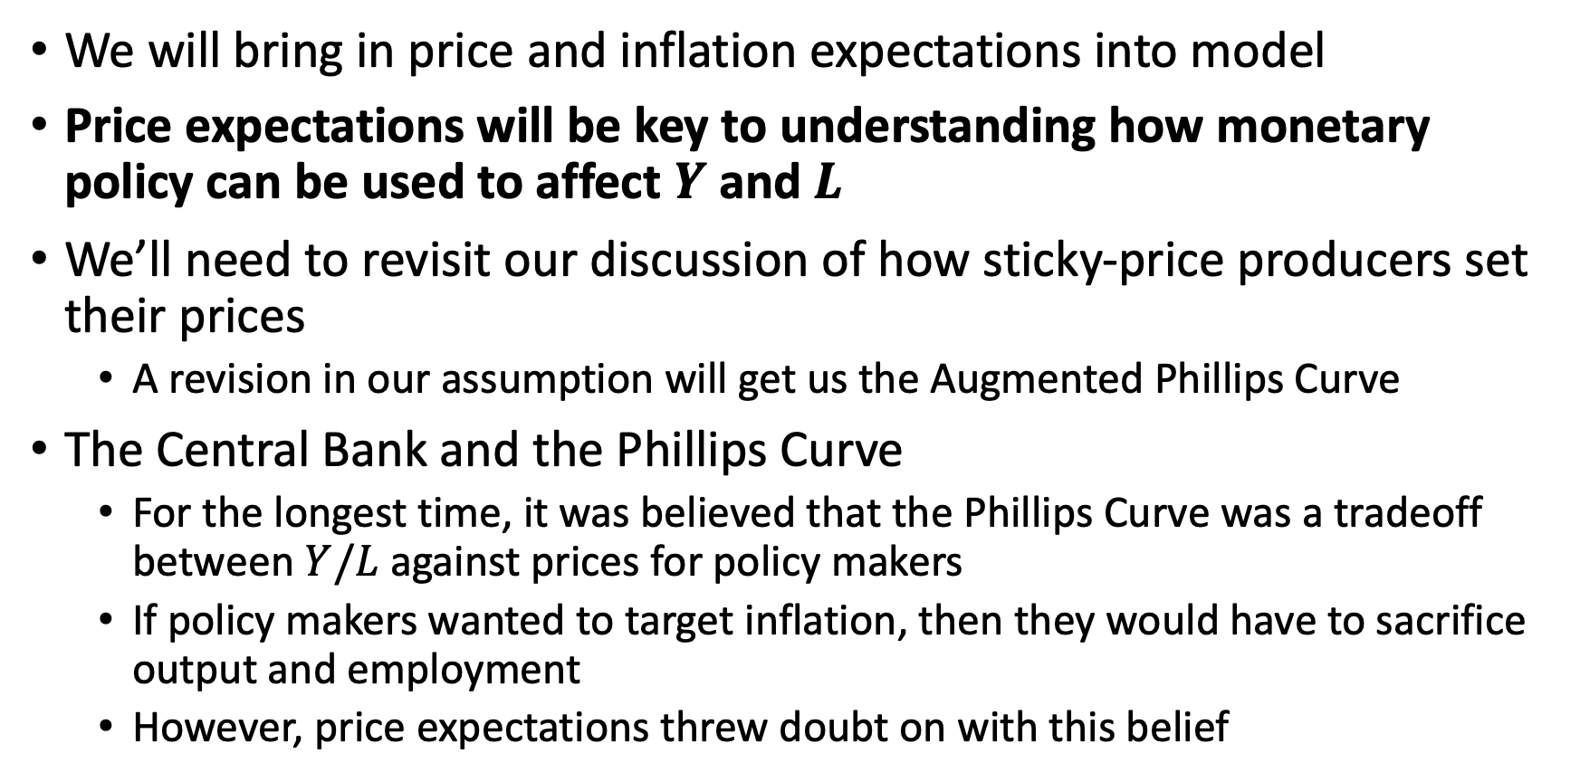
Expectations and Augmented Phillips Curve
We will bring in price and inflation expectations into model
Price expectations will be key to understanding how monetary policy can be used to affect $Y$ and $L$
We’ll need to revisit our discussion of how sticky-price producers set their prices
A revision in our assumption will get us the Augmented Phillips Curve
The Central Bank and the Phillips Curve
For the longest time, it was believed that the Phillips Curve was a tradeoff between $Y/L$ against prices for policy makers
If policy makers wanted to target inflation, then they would have to sacrifice output and employment
However, price expectations threw doubt on with this belief

Slide 26
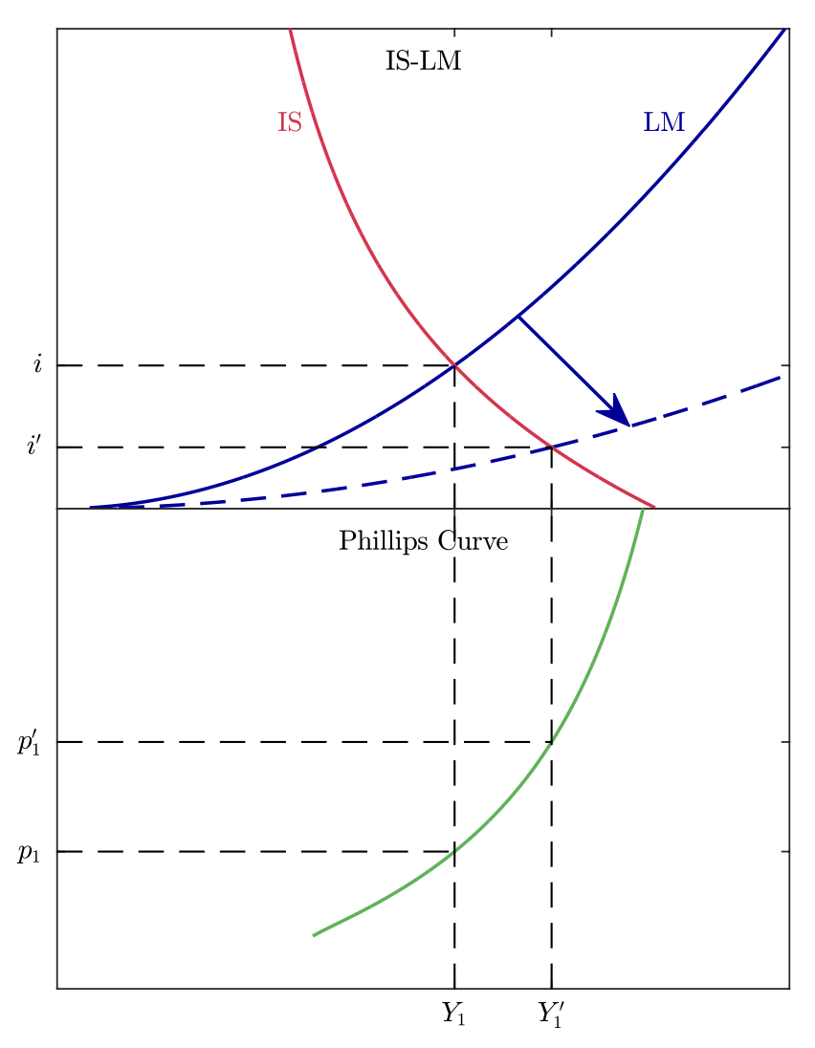
Expectations
It was believed that policy makers could pick any point along the Phillips Curve
If they wanted to expand output, then they would need to increase the money supply
This would increase inflation, but it was believed it could achieve higher levels of output

Slide 27
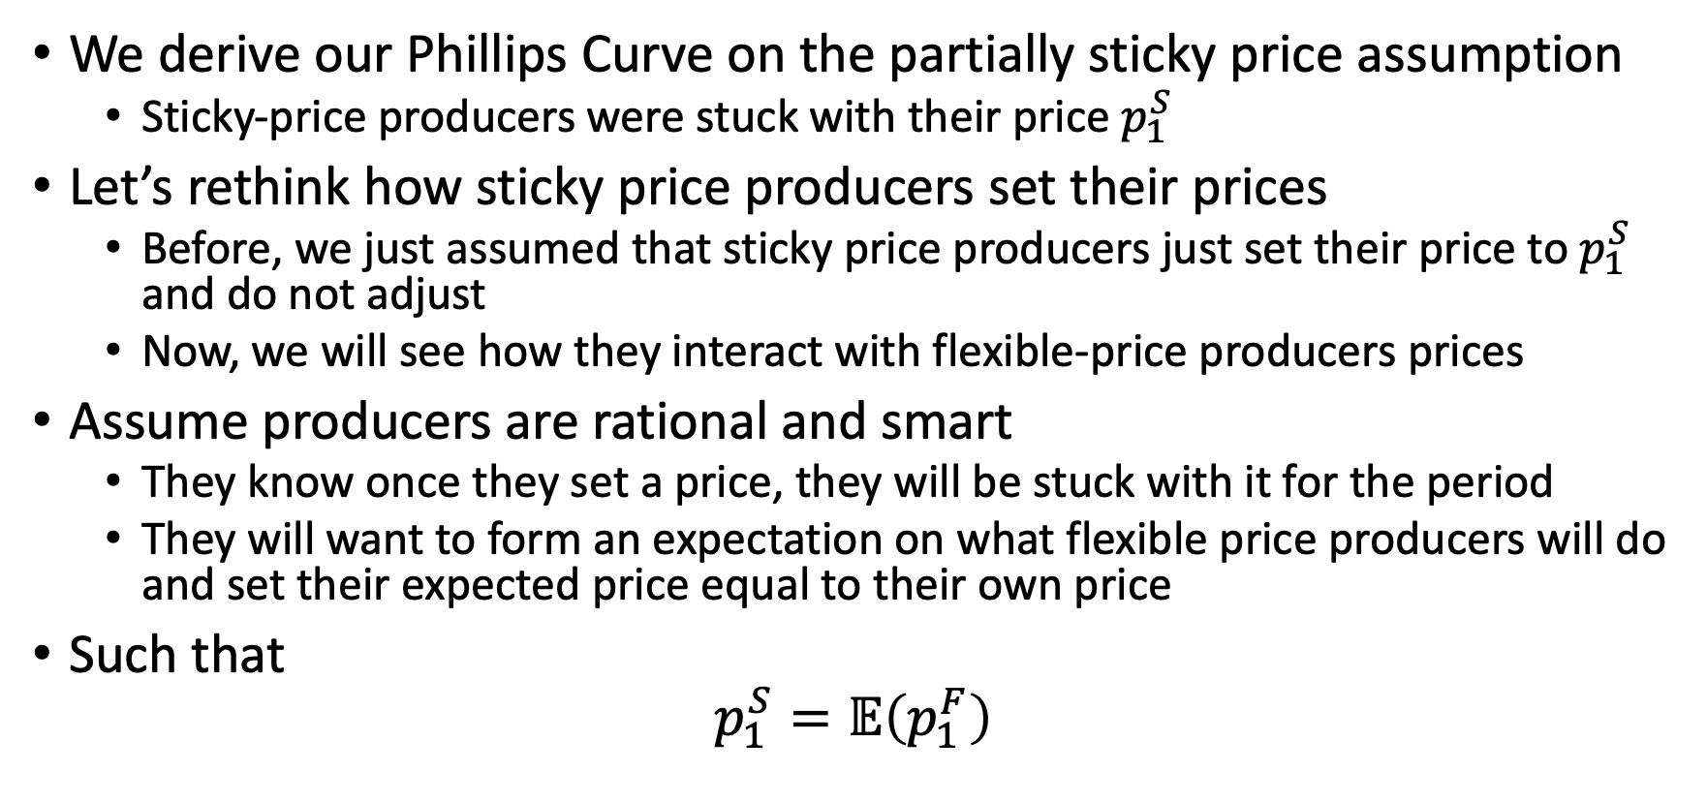
Expectations and Augmented Phillips Curve
We derive our Phillips Curve on the partially sticky price assumption
Sticky-price producers were stuck with their price $p_{1}^{S}$
Let’s rethink how sticky price producers set their prices
Before, we just assumed that sticky price producers just set their price to $p_{1}^{S}$ and do not adjust
Now, we will see how they interact with flexible-price producers prices
Assume producers are rational and smart
They know once they set a price, they will be stuck with it for the period
They will want to form an expectation on what flexible price producers will do and set their expected price equal to their own price
Such that
$$p_{1}^{S}=𝔼\left(p_{1}^{F}\right)$$

Slide 28
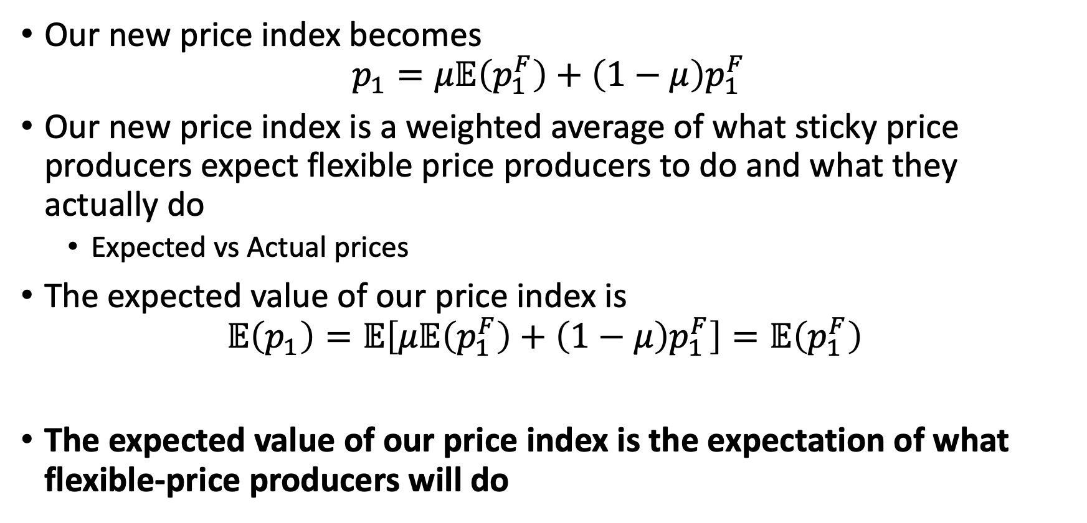
Expectations and Augmented Phillips Curve
Our new price index becomes
$$p_{1}=μ𝔼\left(p_{1}^{F}\right)+\left(1−μ\right)p_{1}^{F}$$
Our new price index is a weighted average of what sticky price producers expect flexible price producers to do and what they actually do
Expected vs Actual prices
The expected value of our price index is
$$𝔼\left(p_{1}\right)=𝔼\left[μ𝔼\left(p_{1}^{F}\right)+\left(1−μ\right)p_{1}^{F}\right]=𝔼\left(p_{1}^{F}\right)$$
The expected value of our price index is the expectation of what flexible-price producers will do

Slide 29
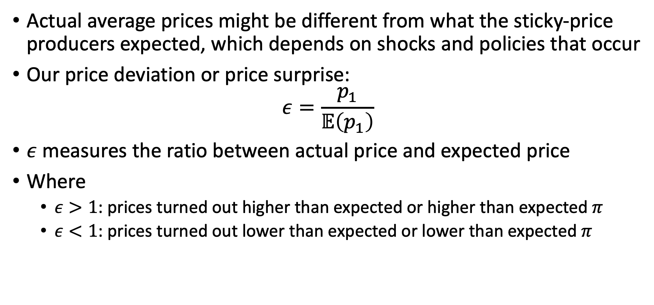
Expectations and Augmented Phillips Curve
Actual average prices might be different from what the sticky-price producers expected, which depends on shocks and policies that occur
Our price deviation or price surprise:
$$ε=\frac{p_{1}}{𝔼\left(p_{1}\right)}$$
$ε$ measures the ratio between actual price and expected price
Where
$ε>1$: prices turned out higher than expected or higher than expected $π$
$ε<1$: prices turned out lower than expected or lower than expected $π$

Slide 30
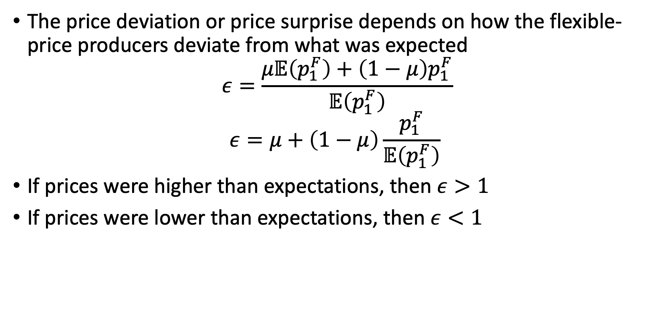
Expectations and Augmented Phillips Curve
The price deviation or price surprise depends on how the flexible-price producers deviate from what was expected
$$ε=\frac{μ𝔼\left(p_{1}^{F}\right)+\left(1−μ\right)p_{1}^{F}}{𝔼\left(p_{1}^{F}\right)}$$
$$ε=μ+\left(1−μ\right)\frac{p_{1}^{F}}{𝔼\left(p_{1}^{F}\right)}$$
If prices were higher than expectations, then $ε>1$
If prices were lower than expectations, then $ε<1$

Slide 31
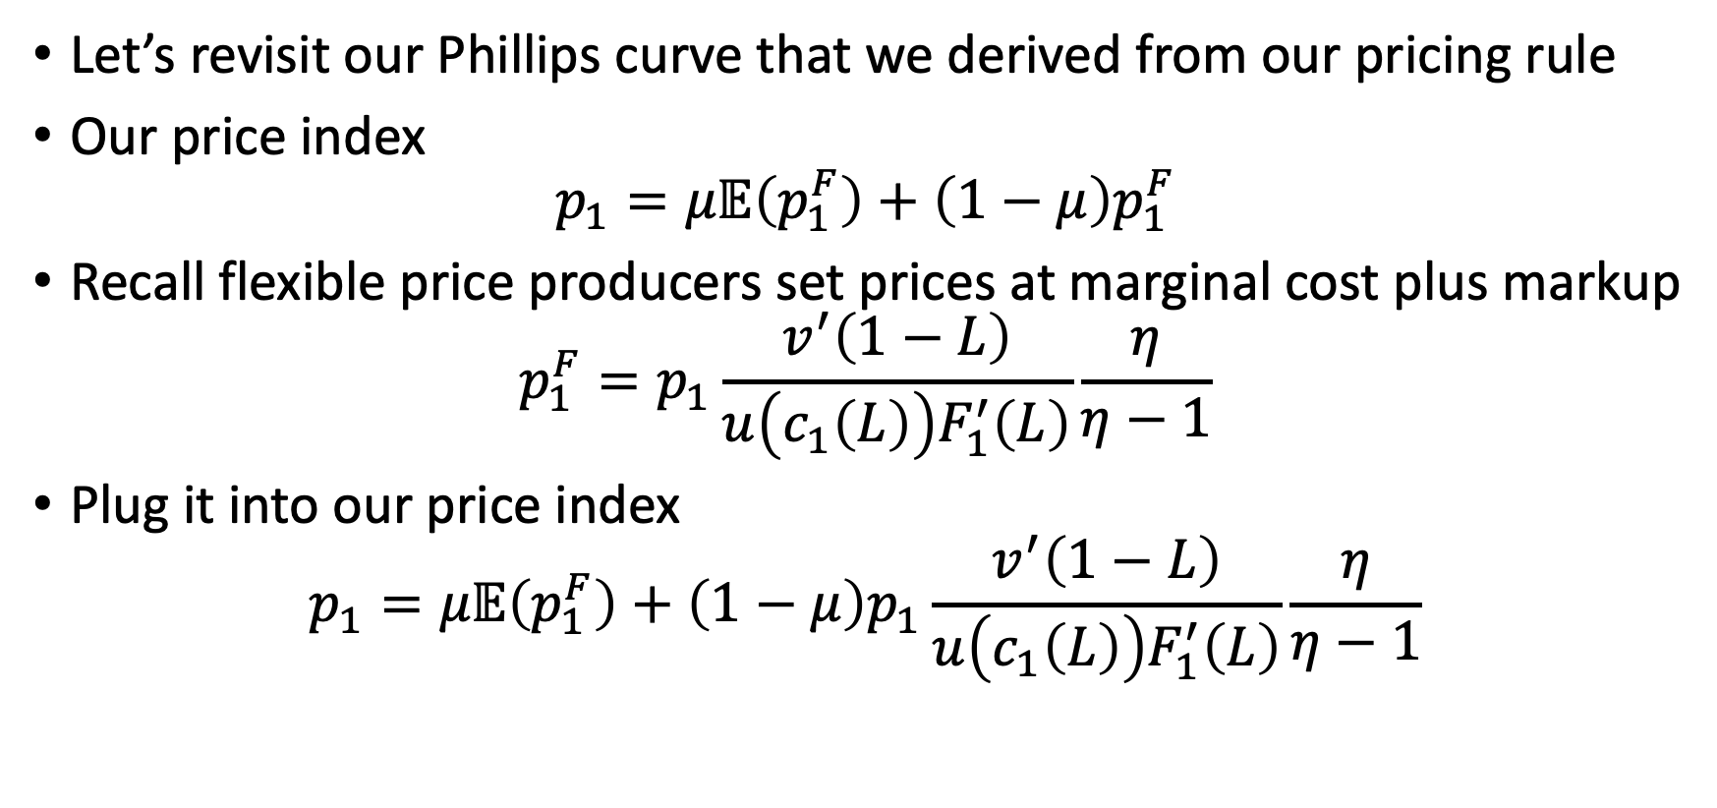
Expectations and Augmented Phillips Curve
Let’s revisit our Phillips curve that we derived from our pricing rule
Our price index
$$p_{1}=μ𝔼\left(p_{1}^{F}\right)+\left(1−μ\right)p_{1}^{F}$$
Recall flexible price producers set prices at marginal cost plus markup
$$p_{1}^{F}=p_{1}\frac{v^{′}\left(1−L\right)}{u\left(c_{1}\left(L\right)\right)F_{1}^{′}\left(L\right)}\frac{η}{η−1}$$
Plug it into our price index
$$p_{1}=μ𝔼\left(p_{1}^{F}\right)+\left(1−μ\right)p_{1}\frac{v^{′}\left(1−L\right)}{u\left(c_{1}\left(L\right)\right)F_{1}^{′}\left(L\right)}\frac{η}{η−1}$$

Slide 32
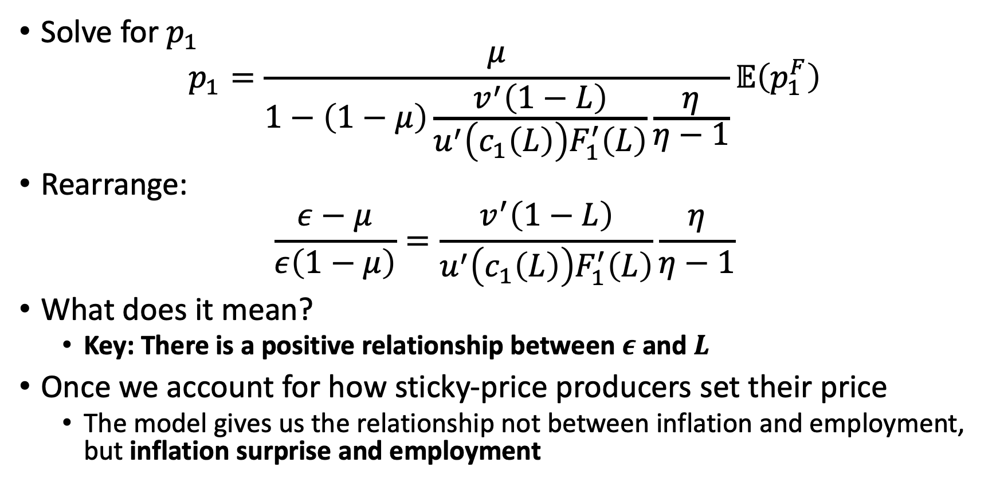
Expectations and Augmented Phillips Curve
Solve for $p_{1}$
$$p_{1}=\frac{μ}{1−\left(1−μ\right)\frac{v^{′}\left(1−L\right)}{u^{′}\left(c_{1}\left(L\right)\right)F_{1}^{′}\left(L\right)}\frac{η}{η−1}}𝔼\left(p_{1}^{F}\right)$$
Rearrange:
$$\frac{ε−μ}{ε\left(1−μ\right)}=\frac{v^{′}\left(1−L\right)}{u^{′}\left(c_{1}\left(L\right)\right)F_{1}^{′}\left(L\right)}\frac{η}{η−1}$$
What does it mean?
Key: There is a positive relationship between $ε$ and $L$
Once we account for how sticky-price producers set their price
The model gives us the relationship not between inflation and employment, but inflation surprise and employment

Slide 33
Rational Expectations and the Natural Rate

Slide 34
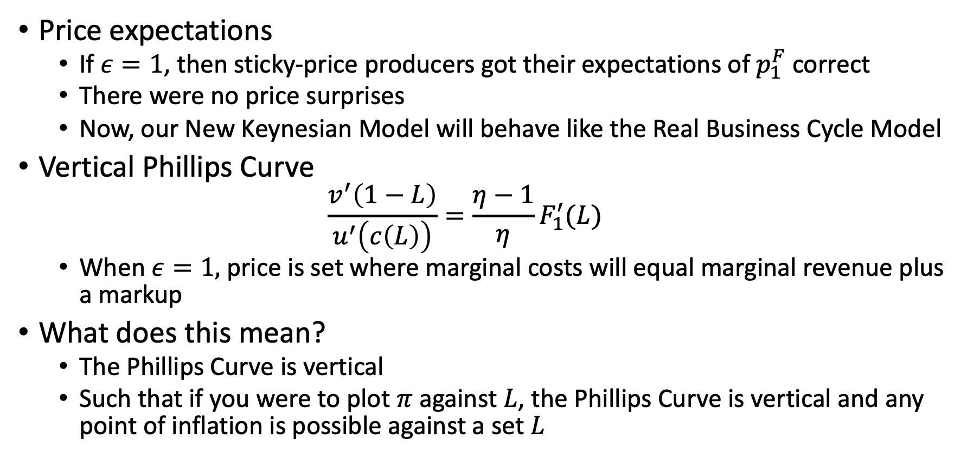
Rational Expectations and the Natural Rate
Price expectations
If $ε=1$, then sticky-price producers got their expectations of $p_{1}^{F}$ correct
There were no price surprises
Now, our New Keynesian Model will behave like the Real Business Cycle Model
Vertical Phillips Curve
$$\frac{v^{′}\left(1−L\right)}{u^{′}\left(c\left(L\right)\right)}=\frac{η−1}{η}F_{1}^{′}(L)$$
When $ε=1,$price is set where marginal costs will equal marginal revenue plus a markup
What does this mean?
The Phillips Curve is vertical
Such that if you were to plot $π$ against $L$, the Phillips Curve is vertical and any point of inflation is possible against a set $L$

Slide 35
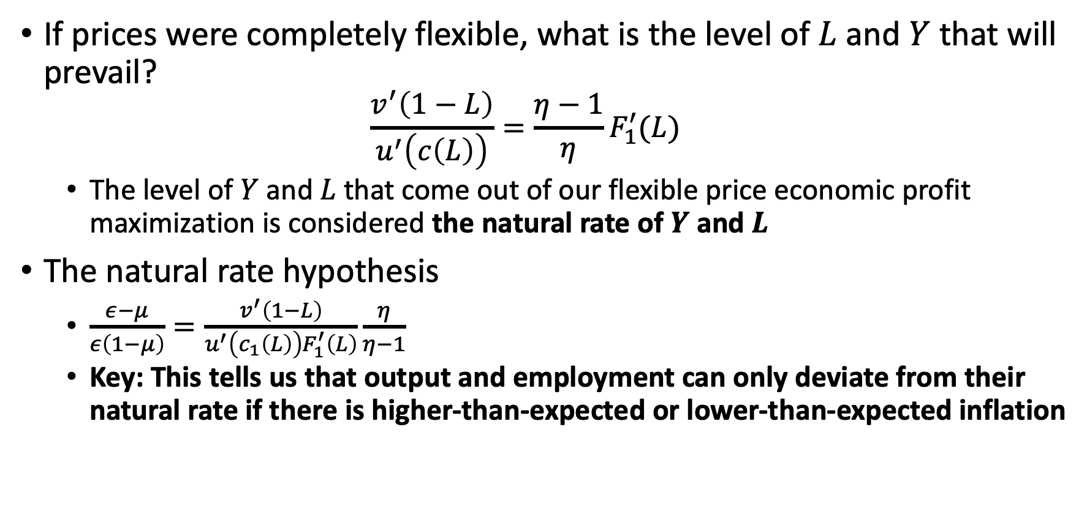
Rational Expectations and the Natural Rate
If prices were completely flexible, what is the level of $L$ and $Y$ that will prevail?
$$\frac{v^{′}\left(1−L\right)}{u^{′}\left(c\left(L\right)\right)}=\frac{η−1}{η}F_{1}^{′}(L)$$
The level of $Y$ and $L$ that come out of our flexible price economic profit maximization is considered the natural rate of $Y$ and $L$
The natural rate hypothesis
$\frac{ε−μ}{ε\left(1−μ\right)}=\frac{v^{′}\left(1−L\right)}{u^{′}\left(c_{1}\left(L\right)\right)F_{1}^{′}\left(L\right)}\frac{η}{η−1}$
Key: This tells us that output and employment can only deviate from their natural rate if there is higher-than-expected or lower-than-expected inflation

Slide 36
Rational Expectations and the Natural Rate
Rational Expectations Hypothesis
How are price expectation formed?
This is one hypothesis for how people form price and inflation expectations
Rational expectations are derived from
Knowledge of how the economy workers,
How the government usually behaves, and
Updates based on all information
Are rational expectations always correct?
No, there will always be random factors (noise) that will cause inflation to differ from inflation expectations
But, the hypothesis says that on average the expectations are correct

Slide 37
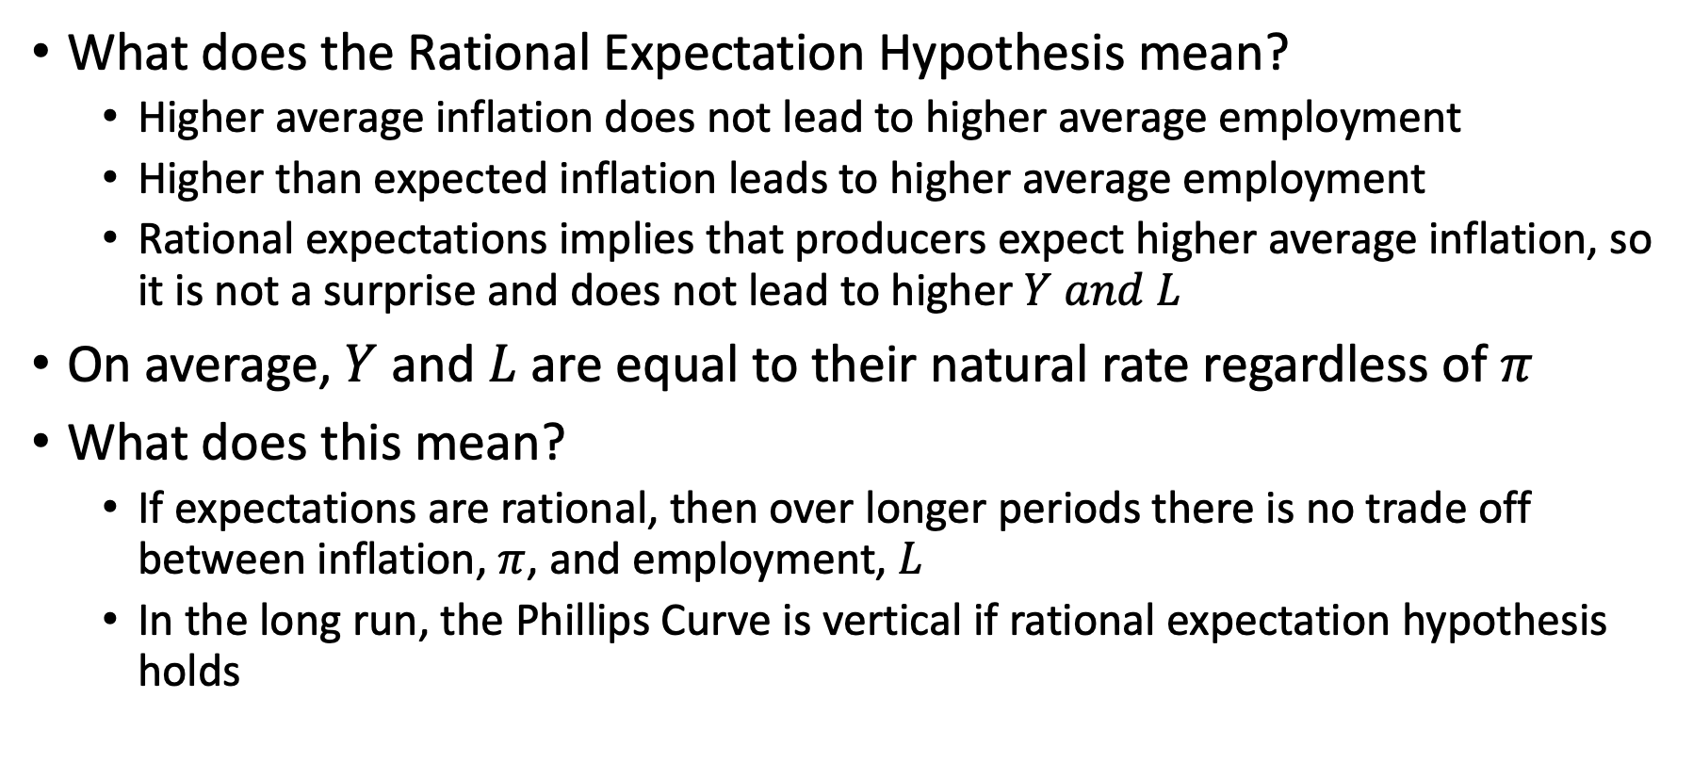
Rational Expectations and the Natural Rate
What does the Rational Expectation Hypothesis mean?
Higher average inflation does not lead to higher average employment
Higher than expected inflation leads to higher average employment
Rational expectations implies that producers expect higher average inflation, so it is not a surprise and does not lead to higher $Y and L$
On average, $Y$ and $L$ are equal to their natural rate regardless of $π$
What does this mean?
If expectations are rational, then over longer periods there is no trade off between inflation, $π$, and employment, $L$
In the long run, the Phillips Curve is vertical if rational expectation hypothesis holds

Slide 38
Rational Expectations and the Natural Rate
Let’s assume we accept the rational expectations hypothesis
How much inflation should producers expect?
Barro and Gordon (1983) set up some game theory to answer this question
What will the government do?
What will sticky-price producers do?
One turn, the government tries to pursue beneficial policies taking the decisions that sticky-price producers have made as given
Another turn, the sticky-price producers try to anticipate what the government will do

Slide 39
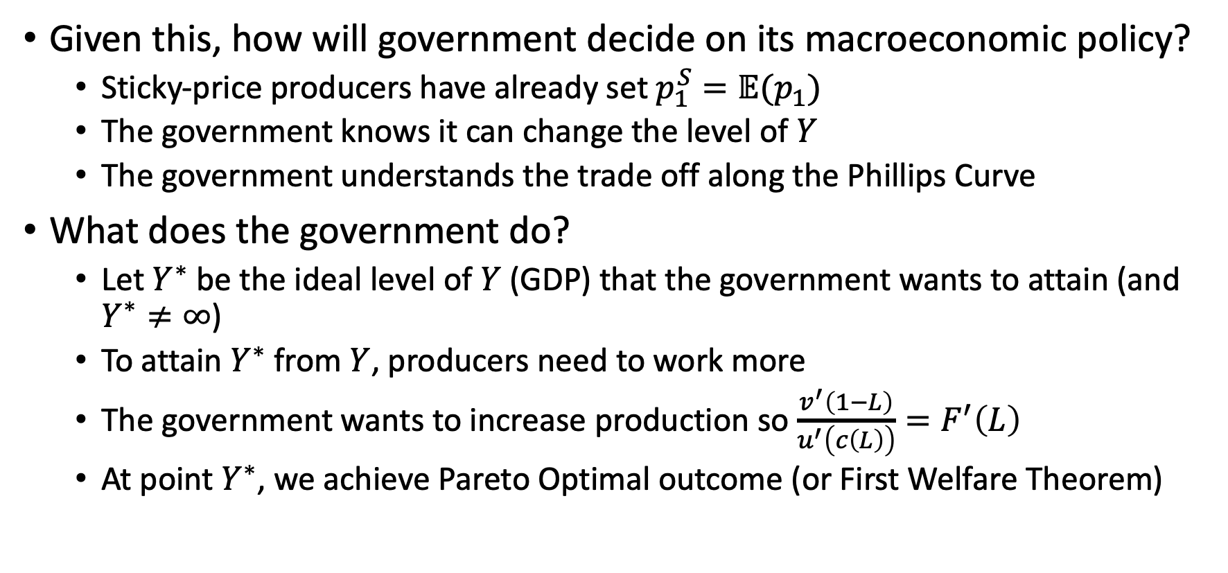
Rational Expectations and the Natural Rate
Given this, how will government decide on its macroeconomic policy?
Sticky-price producers have already set $p_{1}^{S}=𝔼(p_{1})$
The government knows it can change the level of $Y$
The government understands the trade off along the Phillips Curve
What does the government do?
Let $Y^{∗}$ be the ideal level of $Y$ (GDP) that the government wants to attain (and $Y^{∗}≠∞$)
To attain $Y^{∗}$ from $Y$, producers need to work more
The government wants to increase production so $\frac{v^{′}\left(1−L\right)}{u^{′}\left(c\left(L\right)\right)}=F^{′}\left(L\right)$
At point $Y^{∗}$, we achieve Pareto Optimal outcome (or First Welfare Theorem)

Slide 40
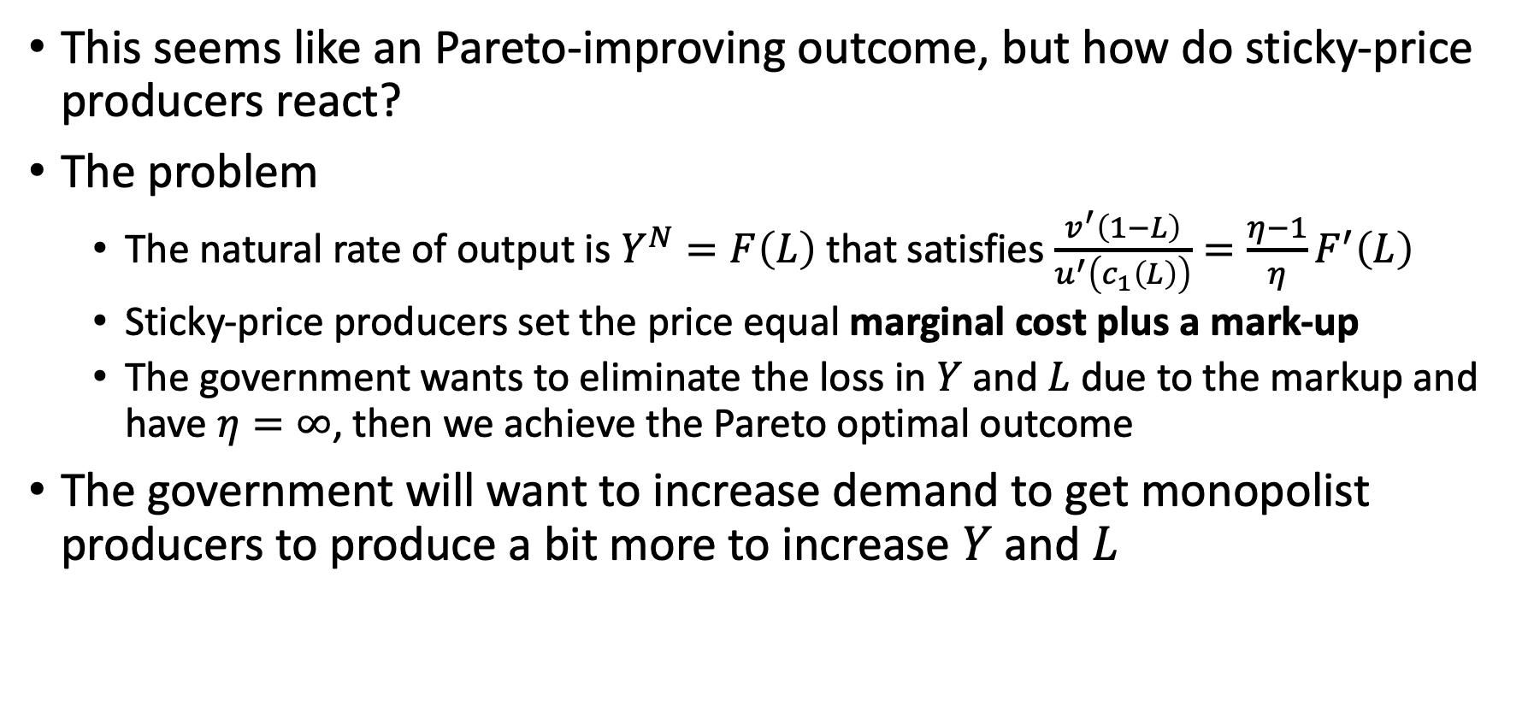
Rational Expectations and the Natural Rate
This seems like an Pareto-improving outcome, but how do sticky-price producers react?
The problem
The natural rate of output is $Y^{N}=F\left(L\right)$ that satisfies $\frac{v^{′}\left(1−L\right)}{u^{′}\left(c_{1}\left(L\right)\right)}=\frac{η−1}{η}F^{′}\left(L\right)$
Sticky-price producers set the price equal marginal cost plus a mark-up
The government wants to eliminate the loss in $Y$ and $L$due to the markup and have $η=∞$, then we achieve the Pareto optimal outcome
The government will want to increase demand to get monopolist producers to produce a bit more to increase $Y$ and $L$

Slide 41
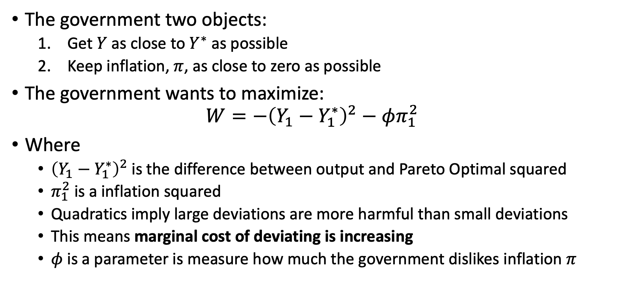
Rational Expectations and the Natural Rate
The government two objects:
Get $Y$ as close to $Y^{∗}$ as possible
Keep inflation, $π$, as close to zero as possible
The government wants to maximize:
$$W=−{\left(Y_{1}−Y_{1}^{∗}\right)}^{2}−φπ_{1}^{2}$$
Where
${\left(Y_{1}−Y_{1}^{∗}\right)}^{2}$ is the difference between output and Pareto Optimal squared
$π_{1}^{2}$ is a inflation squared
Quadratics imply large deviations are more harmful than small deviations
This means marginal cost of deviating is increasing
$φ$ is a parameter is measure how much the government dislikes inflation $π$

Slide 42
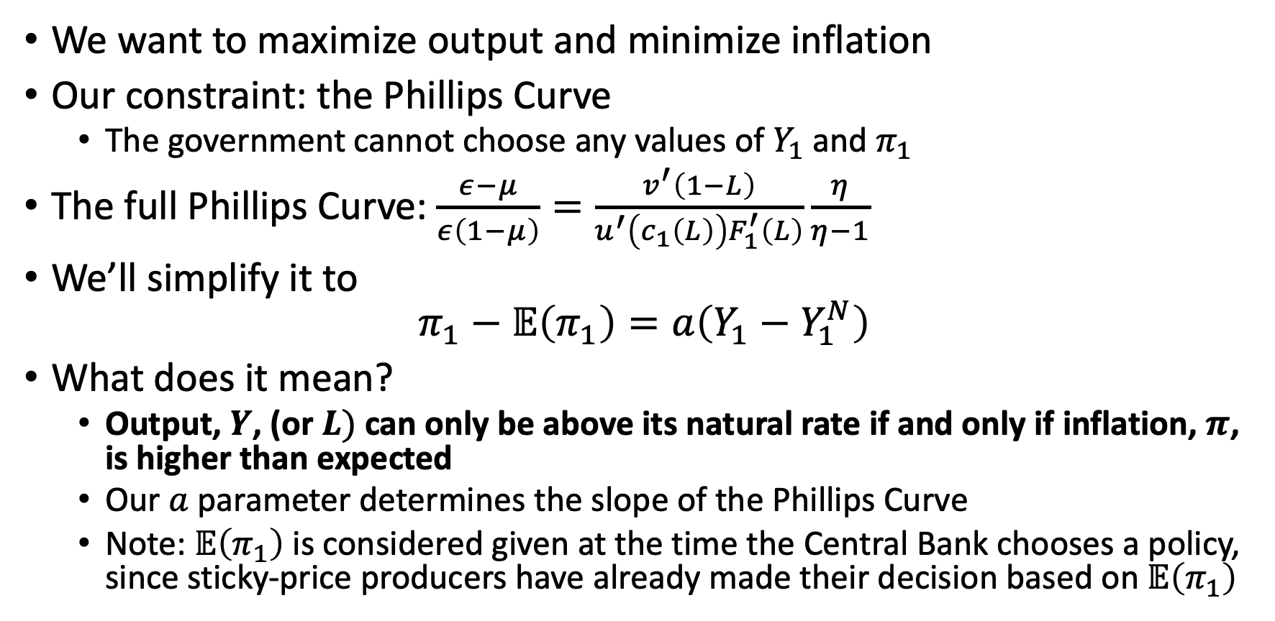
Rational Expectations and the Natural Rate
We want to maximize output and minimize inflation
Our constraint: the Phillips Curve
The government cannot choose any values of $Y_{1}$ and $π_{1}$
The full Phillips Curve: $\frac{ε−μ}{ε\left(1−μ\right)}=\frac{v^{′}\left(1−L\right)}{u^{′}\left(c_{1}\left(L\right)\right)F_{1}^{′}\left(L\right)}\frac{η}{η−1}$
We’ll simplify it to
$$π_{1}−𝔼\left(π_{1}\right)=a\left(Y_{1}−Y_{1}^{N}\right)$$
What does it mean?
Output, $Y$, (or $L)$ can only be above its natural rate if and only if inflation, $π$, is higher than expected
Our $a$ parameter determines the slope of the Phillips Curve
Note: $𝔼\left(π_{1}\right)$ is considered given at the time the Central Bank chooses a policy, since sticky-price producers have already made their decision based on $𝔼\left(π_{1}\right)$

Slide 43
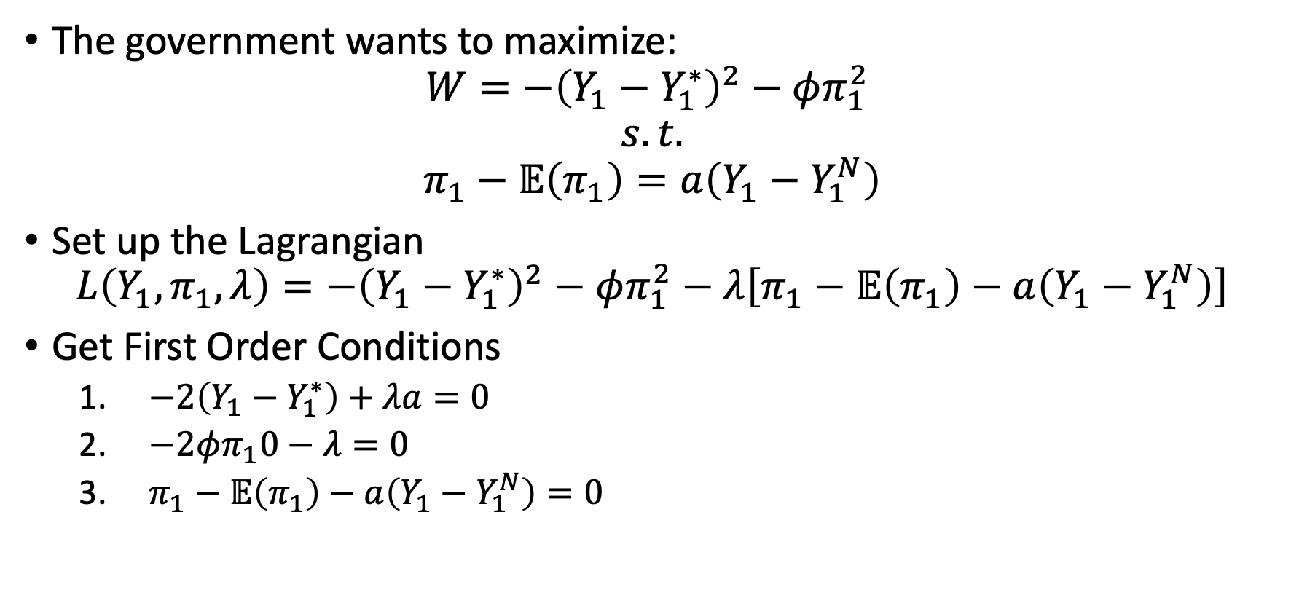
Rational Expectations and the Natural Rate
The government wants to maximize:
$$W=−{\left(Y_{1}−Y_{1}^{∗}\right)}^{2}−φπ_{1}^{2}$$
$$s.t.$$
$$π_{1}−𝔼\left(π_{1}\right)=a\left(Y_{1}−Y_{1}^{N}\right)$$
Set up the Lagrangian
$$L\left(Y_{1},π_{1},λ\right)=−{\left(Y_{1}−Y_{1}^{∗}\right)}^{2}−φπ_{1}^{2}−λ\left[π_{1}−𝔼\left(π_{1}\right)−a\left(Y_{1}−Y_{1}^{N}\right)\right]$$
Get First Order Conditions
$−2\left(Y_{1}−Y_{1}^{∗}\right)+λa=0$
$−2φπ_{1}0−λ=0$
$π_{1}−𝔼\left(π_{1}\right)−a\left(Y_{1}−Y_{1}^{N}\right)=0$

Slide 44
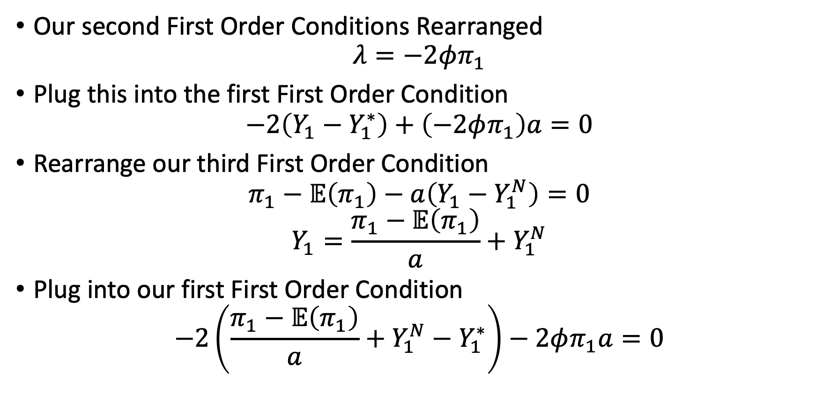
Rational Expectations and the Natural Rate
Our second First Order Conditions Rearranged
$$λ=−2φπ_{1}$$
Plug this into the first First Order Condition
$$−2\left(Y_{1}−Y_{1}^{∗}\right)+\left(−2φπ_{1}\right)a=0$$
Rearrange our third First Order Condition
$$π_{1}−𝔼\left(π_{1}\right)−a\left(Y_{1}−Y_{1}^{N}\right)=0$$
$$Y_{1}=\frac{π_{1}−𝔼\left(π_{1}\right)}{a}+Y_{1}^{N}$$
Plug into our first First Order Condition
$$−2\left(\frac{π_{1}−𝔼\left(π_{1}\right)}{a}+Y_{1}^{N}−Y_{1}^{∗}\right)−2φπ_{1}a=0$$

Slide 45
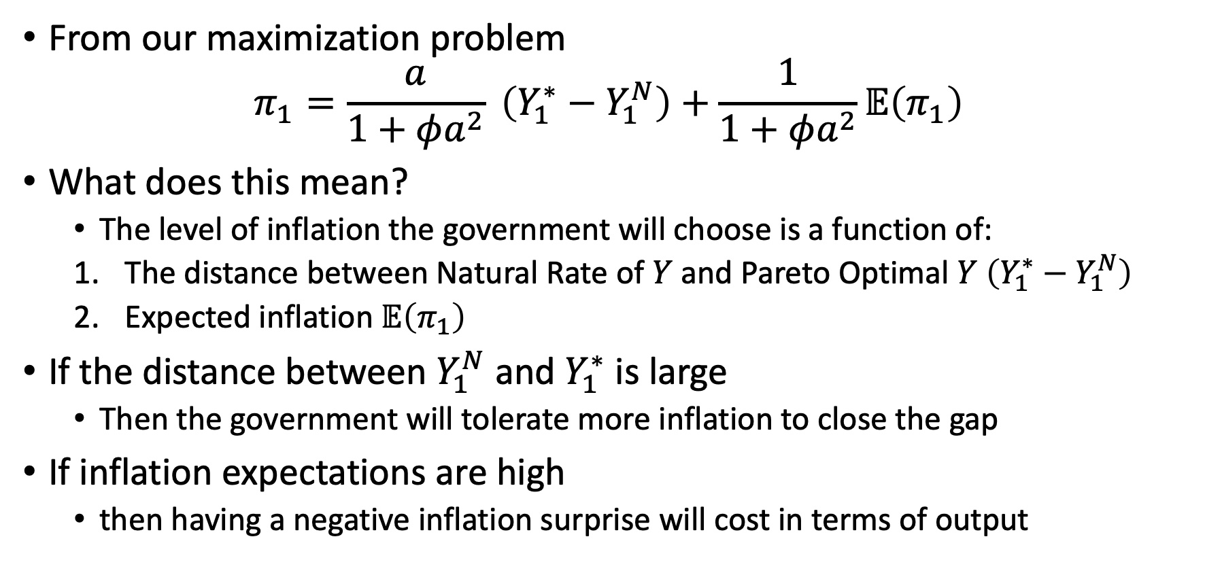
Rational Expectations and the Natural Rate
From our maximization problem
$$π_{1}=\frac{a}{1+φa^{2}} \left(Y_{1}^{∗}−Y_{1}^{N}\right)+\frac{1}{1+φa^{2}}𝔼\left(π_{1}\right)$$
What does this mean?
The level of inflation the government will choose is a function of:
The distance between Natural Rate of $Y$ and Pareto Optimal $Y$ $\left(Y_{1}^{∗}−Y_{1}^{N}\right)$
Expected inflation $𝔼\left(π_{1}\right)$
If the distance between $Y_{1}^{N}$ and $Y_{1}^{∗}$ is large
Then the government will tolerate more inflation to close the gap
If inflation expectations are high
then having a negative inflation surprise will cost in terms of output

Slide 46
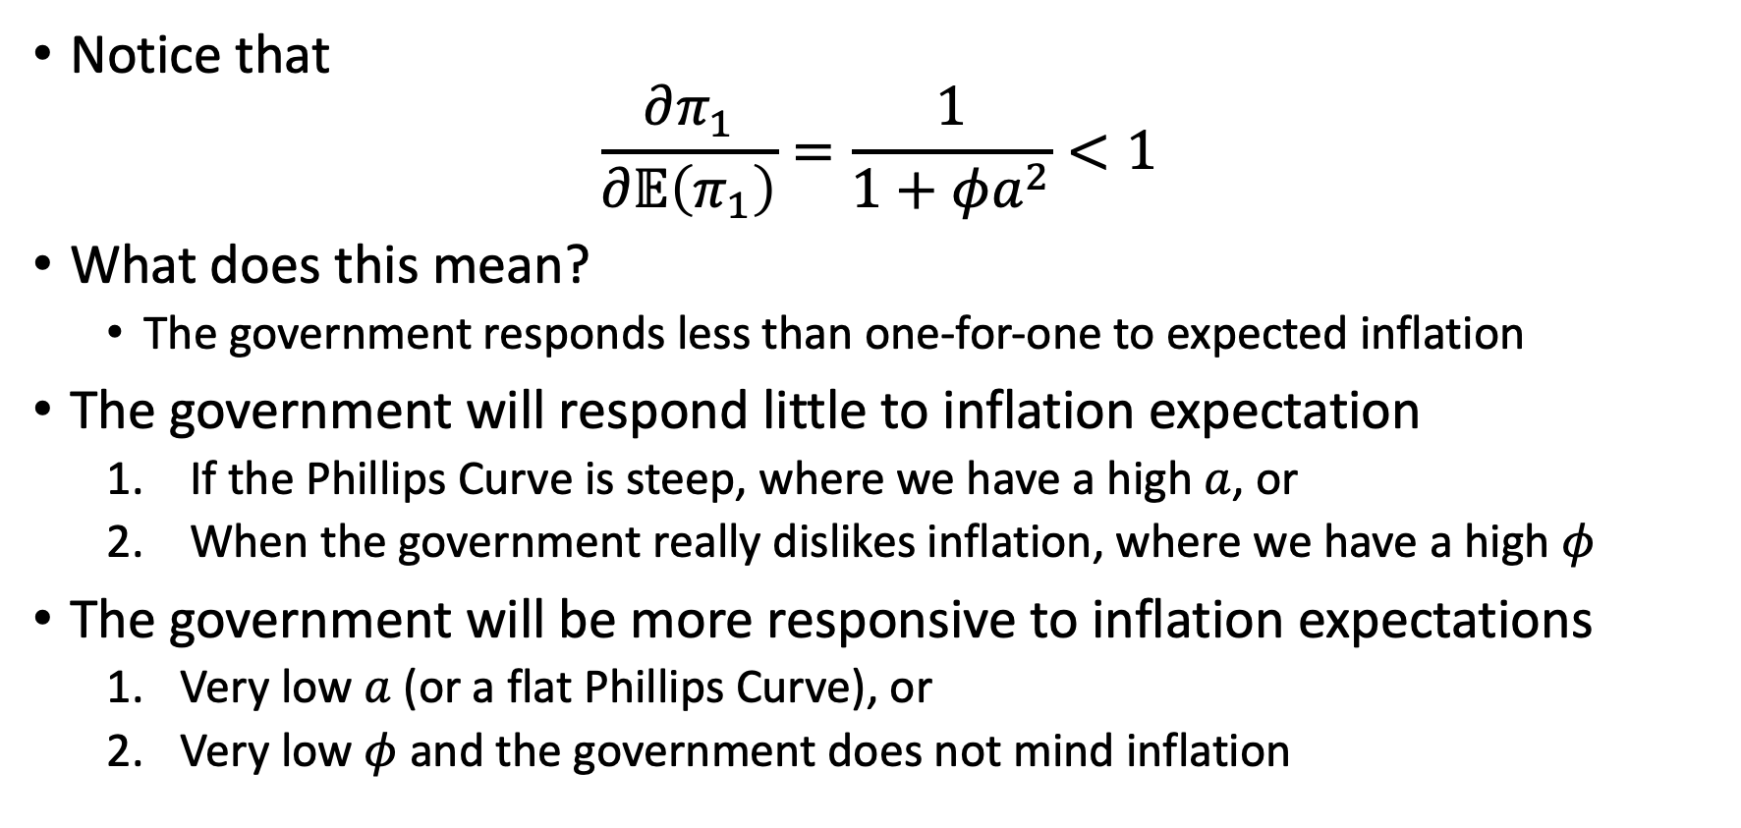
Rational Expectations and the Natural Rate
Notice that
$$\frac{∂π_{1}}{∂𝔼\left(π_{1}\right)}=\frac{1}{1+φa^{2}}<1$$
What does this mean?
The government responds less than one-for-one to expected inflation
The government will respond little to inflation expectation
If the Phillips Curve is steep, where we have a high $a$, or
When the government really dislikes inflation, where we have a high $φ$
The government will be more responsive to inflation expectations
Very low $a$ (or a flat Phillips Curve), or
Very low $φ$ and the government does not mind inflation

Slide 47
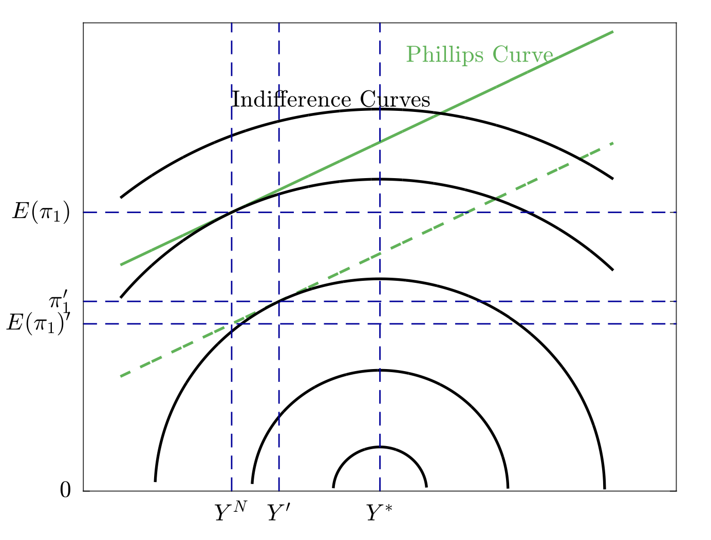
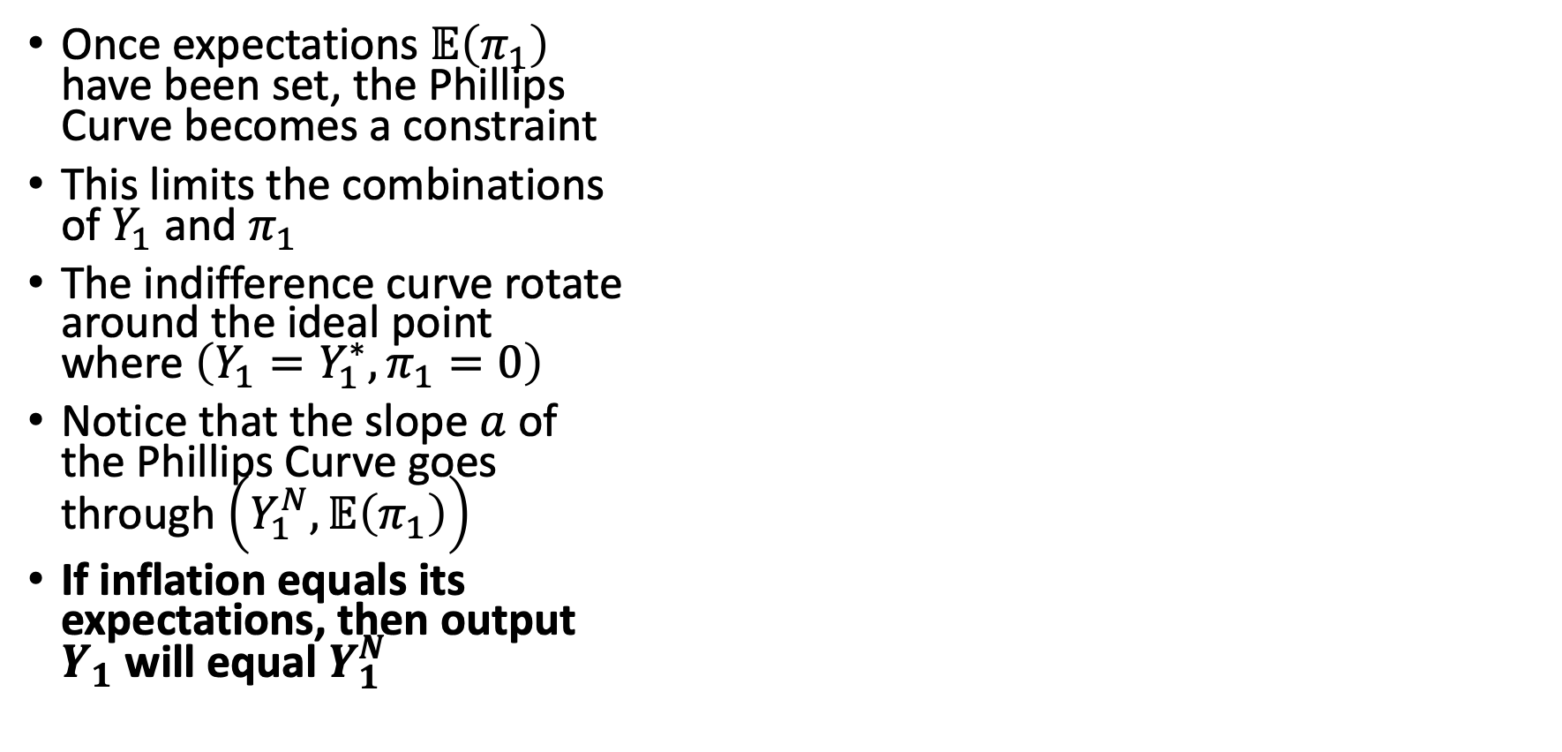
Rational Expectations and the Natural Rate
Once expectations $𝔼\left(π_{1}\right)$ have been set, the Phillips Curve becomes a constraint
This limits the combinations of $Y_{1}$ and $π_{1}$
The indifference curve rotate around the ideal point where $\left(Y_{1}=Y_{1}^{∗},π_{1}=0\right)$
Notice that the slope $a$ of the Phillips Curve goes through $\left(Y_{1}^{N},𝔼\left(π_{1}\right)\right)$
If inflation equals its expectations, then output $Y_{1}$ will equal $Y_{1}^{N}$

Slide 48
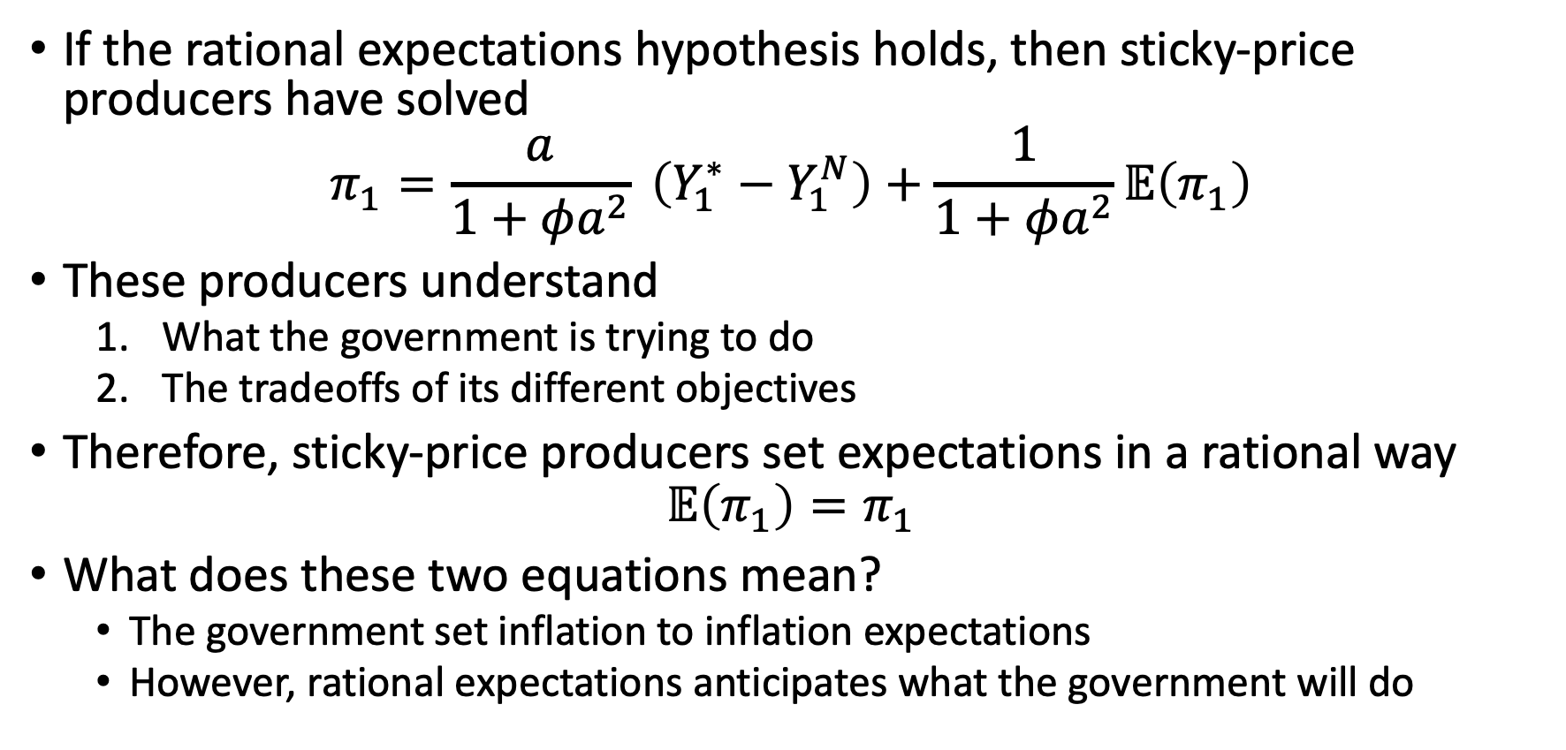
Rational Expectations and the Natural Rate
If the rational expectations hypothesis holds, then sticky-price producers have solved
$$π_{1}=\frac{a}{1+φa^{2}} \left(Y_{1}^{∗}−Y_{1}^{N}\right)+\frac{1}{1+φa^{2}}𝔼\left(π_{1}\right)$$
These producers understand
What the government is trying to do
The tradeoffs of its different objectives
Therefore, sticky-price producers set expectations in a rational way
$$𝔼\left(π_{1}\right)=π_{1}$$
What does these two equations mean?
The government set inflation to inflation expectations
However, rational expectations anticipates what the government will do

Slide 49
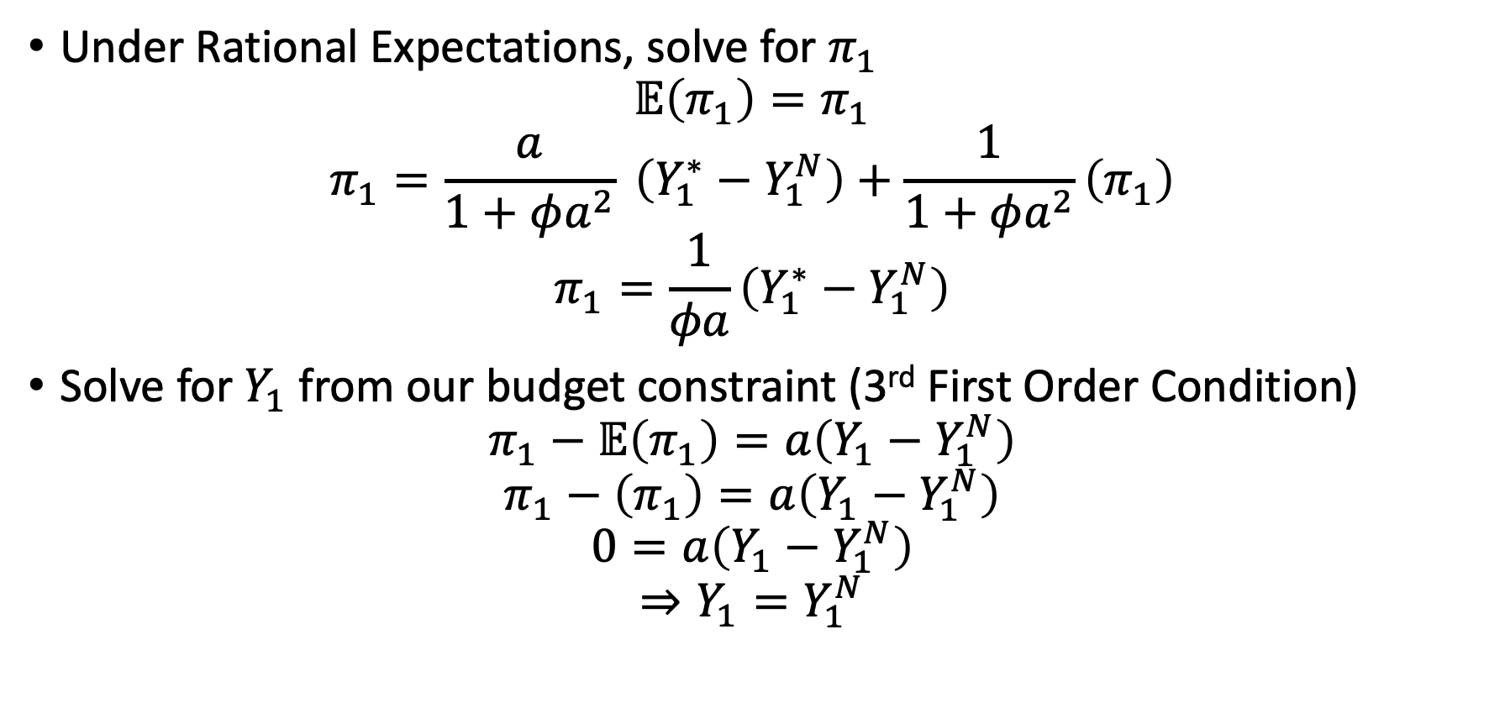
Rational Expectations and the Natural Rate
Under Rational Expectations, solve for $π_{1}$
$$𝔼\left(π_{1}\right)=π_{1}$$
$$π_{1}=\frac{a}{1+φa^{2}} \left(Y_{1}^{∗}−Y_{1}^{N}\right)+\frac{1}{1+φa^{2}}\left(π_{1}\right)$$
$$π_{1}=\frac{1}{φa}\left(Y_{1}^{∗}−Y_{1}^{N}\right)$$
Solve for $Y_{1}$ from our budget constraint (3rd First Order Condition)
$$π_{1}−𝔼\left(π_{1}\right)=a\left(Y_{1}−Y_{1}^{N}\right)$$
$$π_{1}−\left(π_{1}\right)=a\left(Y_{1}−Y_{1}^{N}\right)$$
$$0=a\left(Y_{1}−Y_{1}^{N}\right)$$
$$⇒Y_{1}=Y_{1}^{N}$$

Slide 50
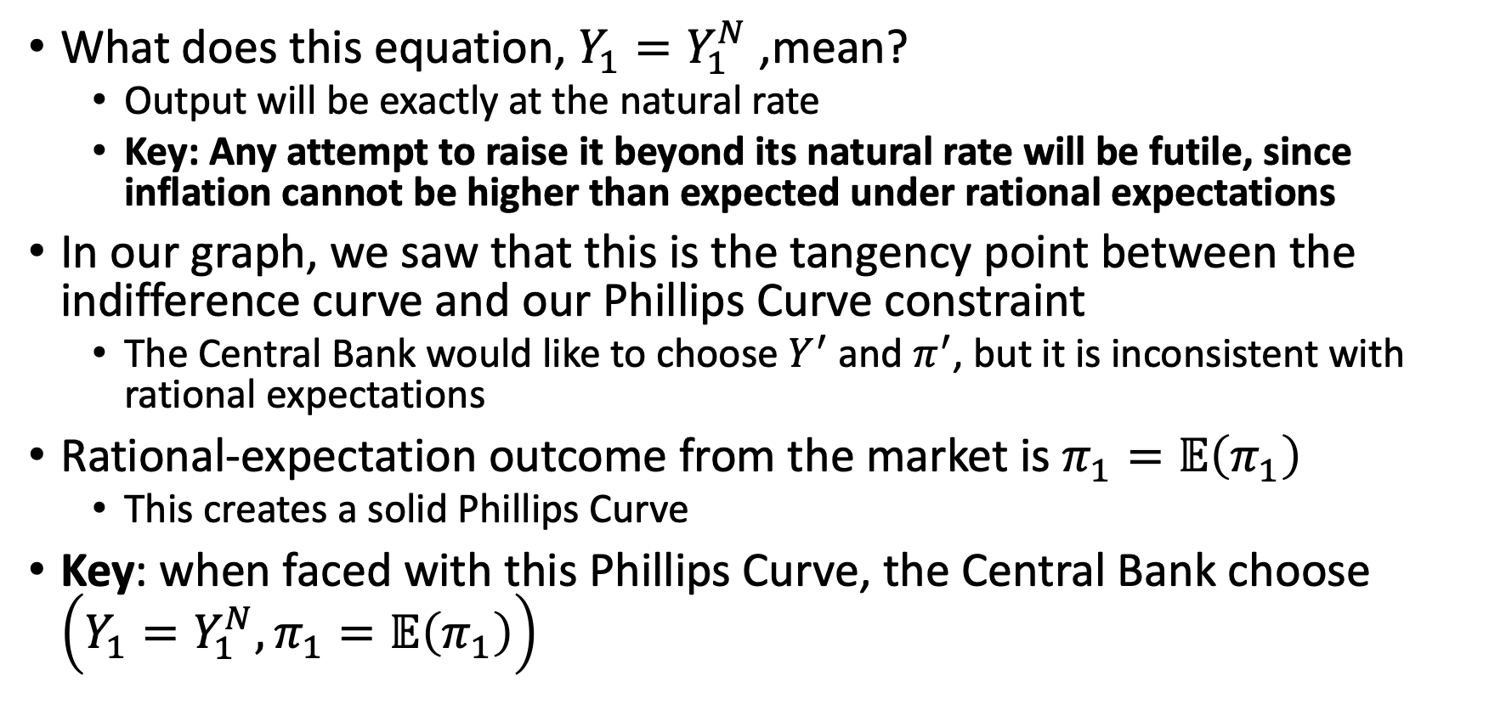
Rational Expectations and the Natural Rate
What does this equation, $Y_{1}=Y_{1}^{N}$ ,mean?
Output will be exactly at the natural rate
Key: Any attempt to raise it beyond its natural rate will be futile, since inflation cannot be higher than expected under rational expectations
In our graph, we saw that this is the tangency point between the indifference curve and our Phillips Curve constraint
The Central Bank would like to choose $Y^{′}$ and $π^{′}$, but it is inconsistent with rational expectations
Rational-expectation outcome from the market is $π_{1}=𝔼\left(π_{1}\right)$
This creates a solid Phillips Curve
Key: when faced with this Phillips Curve, the Central Bank choose $\left({Y_{1}=Y}_{1}^{N},π_{1}=𝔼\left(π_{1}\right)\right)$

Slide 51
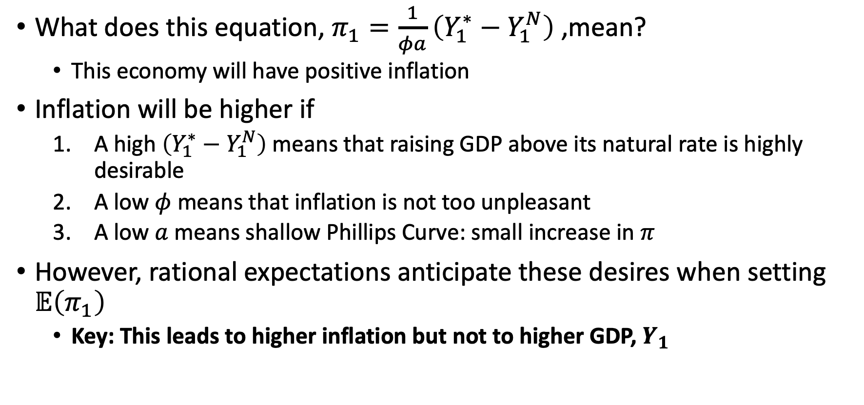
Rational Expectations and the Natural Rate
What does this equation, $π_{1}=\frac{1}{φa}\left(Y_{1}^{∗}−Y_{1}^{N}\right)$ ,mean?
This economy will have positive inflation
Inflation will be higher if
A high $\left(Y_{1}^{∗}−Y_{1}^{N}\right)$ means that raising GDP above its natural rate is highly desirable
A low $φ$ means that inflation is not too unpleasant
A low $a$ means shallow Phillips Curve: small increase in $π$
However, rational expectations anticipate these desires when setting $𝔼\left(π_{1}\right)$
Key: This leads to higher inflation but not to higher GDP, $Y_{1}$

Slide 52
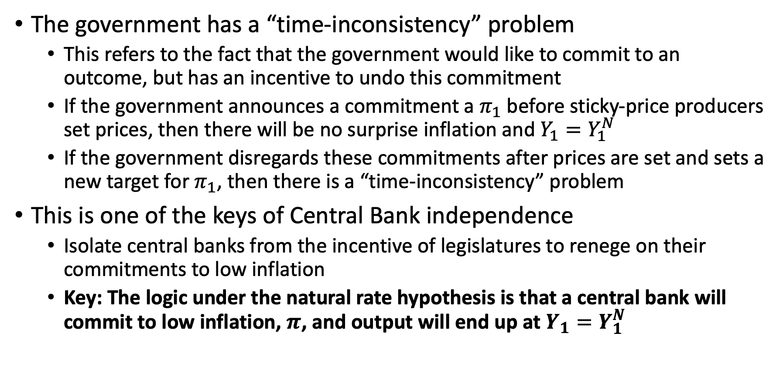
Rational Expectations and the Natural Rate
The government has a “time-inconsistency” problem
This refers to the fact that the government would like to commit to an outcome, but has an incentive to undo this commitment
If the government announces a commitment a $π_{1}$ before sticky-price producers set prices, then there will be no surprise inflation and $Y_{1}=Y_{1}^{N}$
If the government disregards these commitments after prices are set and sets a new target for $π_{1}$, then there is a “time-inconsistency” problem
This is one of the keys of Central Bank independence
Isolate central banks from the incentive of legislatures to renege on their commitments to low inflation
Key: The logic under the natural rate hypothesis is that a central bank will commit to low inflation, $π$, and output will end up at $Y_{1}=Y_{1}^{N}$

Slide 53
Types of Monetary Regimes

Slide 54
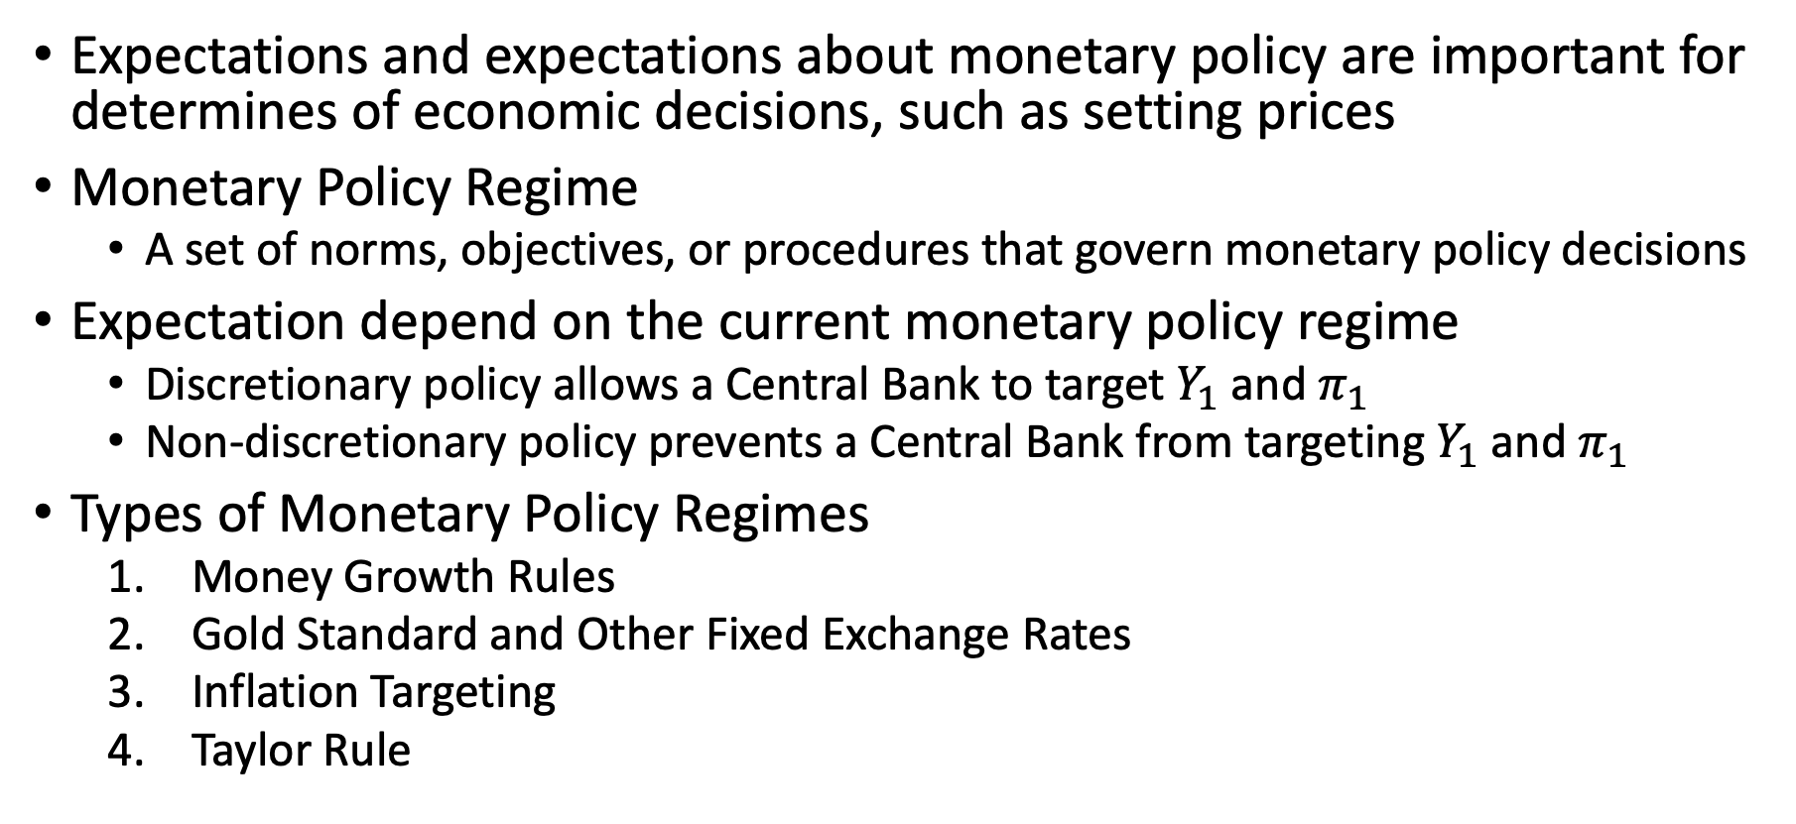
Types of Monetary Policy Regimes
Expectations and expectations about monetary policy are important for determines of economic decisions, such as setting prices
Monetary Policy Regime
A set of norms, objectives, or procedures that govern monetary policy decisions
Expectation depend on the current monetary policy regime
Discretionary policy allows a Central Bank to target $Y_{1}$ and $π_{1}$
Non-discretionary policy prevents a Central Bank from targeting $Y_{1}$ and $π_{1}$
Types of Monetary Policy Regimes
Money Growth Rules
Gold Standard and Other Fixed Exchange Rates
Inflation Targeting
Taylor Rule

Slide 55
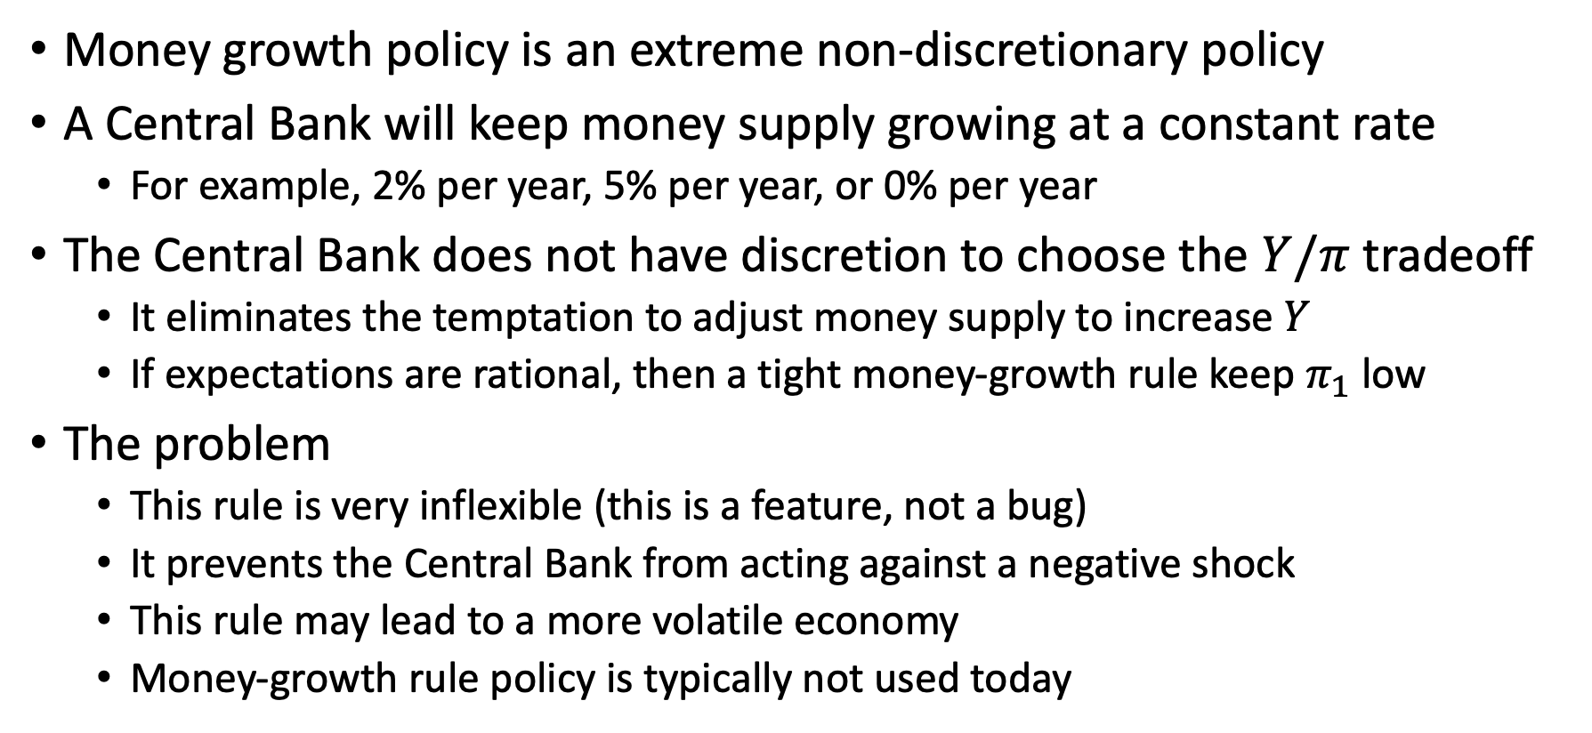
Money Growth Rule
Money growth policy is an extreme non-discretionary policy
A Central Bank will keep money supply growing at a constant rate
For example, 2% per year, 5% per year, or 0% per year
The Central Bank does not have discretion to choose the $Y/π$ tradeoff
It eliminates the temptation to adjust money supply to increase $Y$
If expectations are rational, then a tight money-growth rule keep $π_{1}$ low
The problem
This rule is very inflexible (this is a feature, not a bug)
It prevents the Central Bank from acting against a negative shock
This rule may lead to a more volatile economy
Money-growth rule policy is typically not used today

Slide 56
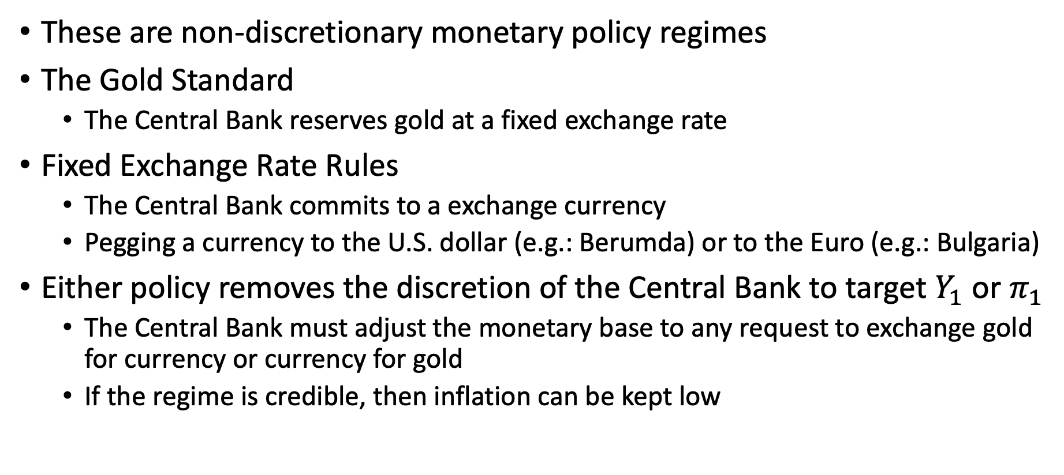
Gold Standard and Fixed Exchange Rate Rules
These are non-discretionary monetary policy regimes
The Gold Standard
The Central Bank reserves gold at a fixed exchange rate
Fixed Exchange Rate Rules
The Central Bank commits to a exchange currency
Pegging a currency to the U.S. dollar (e.g.: Berumda) or to the Euro (e.g.: Bulgaria)
Either policy removes the discretion of the Central Bank to target $Y_{1}$ or $π_{1}$
The Central Bank must adjust the monetary base to any request to exchange gold for currency or currency for gold
If the regime is credible, then inflation can be kept low

Slide 57
Gold Standard and Fixed Exchange Rate Rules
The problem: It is fixed one one particular good or currency
If the price of this good or currency changes with respect to other goods or currency, then there will be side effects
These side effects include deflation or inflation
Suppose that there is an increase in demand for jewelry, then there will be an increase in the demand for gold
The Central Bank has committed to keeping the nominal price of gold in terms of currency fixed
This means that the nominal price of other goods has to fall
The Central Bank will be forced to contract the money supply, which can create deflation and a fall in GDP

Slide 58

Inflation Targeting Rule
This is a discretionary policy where the Central Bank gives a formal mandate to keep inflation as close as possible to a pre-set target
For example, the Central Bank commits to 2% inflation
This discretionary policy focuses only on inflation
The Central Bank will not focus on changes in $Y_{1}$ or $L$
The sole focus is to keep $π_{1}$ at the pre-set target
The benefit
The Central Bank can respond to shocks without the full discretion to set policy that can lead to inflation bias

Slide 59


Inflation Targeting Rule
Suppose there is a negative shock that shifts our IS curve to the left
$Y_{1}, i,$and $p_{1}$ all fall to $Y_{1}^{′}, i^{′},$ and $p_{1}^{′}$
We would have a deflationary event without a Central Bank intervention
Under inflationary targeting, the Central Bank will increase $M^{S}$ and shift the LM curve to the right
From this policy, $Y_{1}$ and $p_{1}$ return while $i′$ falls to $i′′$
Blanchard and Gali (2007) calls this a “Divine coincidence”

Slide 60


Inflation Targeting Rule
Suppose there is a productivity shock which shifts our Phillips Curve down
$Y_{1}$ increase to $Y_{1}^{′}$
$p_{1}$ falls to $p_{1}^{′}$ and $i$ falls to $i^{′}$
In order to keep their inflation target the Central Bank increase $M^{S}$
But, this lowers $i$ even more to $i^{′′}$, which increases $c_{1}$ and $K$ higher which increase $Y_{1}$ to $Y_{1}^{′}$
In this example, inflation targeting does not stabilize $Y_{1}$

Slide 61

Taylor Rule
The Taylor Rule is a discretionary policy regime named after Taylor (1993)
It is similar to inflation targeting but provides room to fix mistakes
First, the Central Bank sets a inflation target to attain: $π_{1}^{∗}$
Then, it sets the nominal interest rate $i$ according to
$$i=r^{N}+π+a\left(π−π^{∗}\right)+b\left(Y−Y^{N}\right)$$
Where
$Y^{N}$ is the natural rate of real GDP
$π^{∗}$ is the target level of inflation
$r^{N}$ is the natural rate of real interest
$a$ and $b$ are weight parameters, which are typically $a=0.5$ and $b=0.5$

Slide 62

Taylor Rule
The Taylor rule attempts to keep the economy at the natural level of GDP, $Y^{N}$ (not $Y^{∗})$ and the inflation target $π^{∗}$
If the Central Bank succeeds in keeping both $Y$ and $π$ on target, then it just sets the interest rate to $i=r^{N}+π^{∗}$
The natural rate of real interest plus the inflation target
If inflation starts to deviate from its target, the Central Bank adjusts the nominal interest rate upward
$$\frac{∂i}{∂π}=1+a>1$$
This means that nominal interest rate adjust more than one-for-one to deviations from its inflation target

Slide 63

Taylor Rule
The Taylor principle
If inflation starts to rise above its inflation target, then Central Bank increase the real interest rate.
This implies a leftward movement along the IS and Phillips Curve which lowers both $Y_{1}$ and $π_{1}$
If a recession starts, $Y$ will be below its natural rate $Y^{N}$, so the Central Bank will tolerate an increase in inflation to prevent $Y$ from falling below its target $Y^{N}$
The Taylor Rule is similar to a thermostat
It adjusts the intensity of the boiler to keep the temperature at a set target
The Central Bank adjusts the interest rate to keep both $Y$ and $π$ near their targets
Note: Inflation Targeting Rule is a special case of the Taylor Rule where $a→∞$ and $b=0$

Slide 64
Limits on Monetary Policy and The Liquidity Trap

Slide 65


Zero Lower Bound on Nominal Interest Rates
Monetary Policy can be used to offset negative shocks, but increasing $M^{S}$ and decreasing $i$
The Zero Lower Bound on Nominal Interest Rates a limit
The LM curve can never go below $i=0$
The LM curve is just money-market equilibrium
If $i=0$, then there is no opportunity costs for holding money
Assets pay negative interest, so people just hold money

Slide 66


Liquidity Trap
Suppose the is a large negative shock that reduces IS greatly
It is so large it bring $i$ near or at 0 with expansionary monetary policy
However, it is still not enough to increase $Y_{1}$ back to its original level
This is called the liquidity trap
Conventional monetary policy has little ability to help the economy at this point

Slide 67

Liquidity Trap
To deal with a liquidity trap it is better to use fiscal policy to increase $G$
In a liquidity trap, there is no crowding out
An increase in $G$ leads to a one-to- one increase in higher output
This was a rational for the ARRA of 2009 and the CARES Act of 2020

